Slide 1
Training keys
Jonathan Yarwood

Slide 2
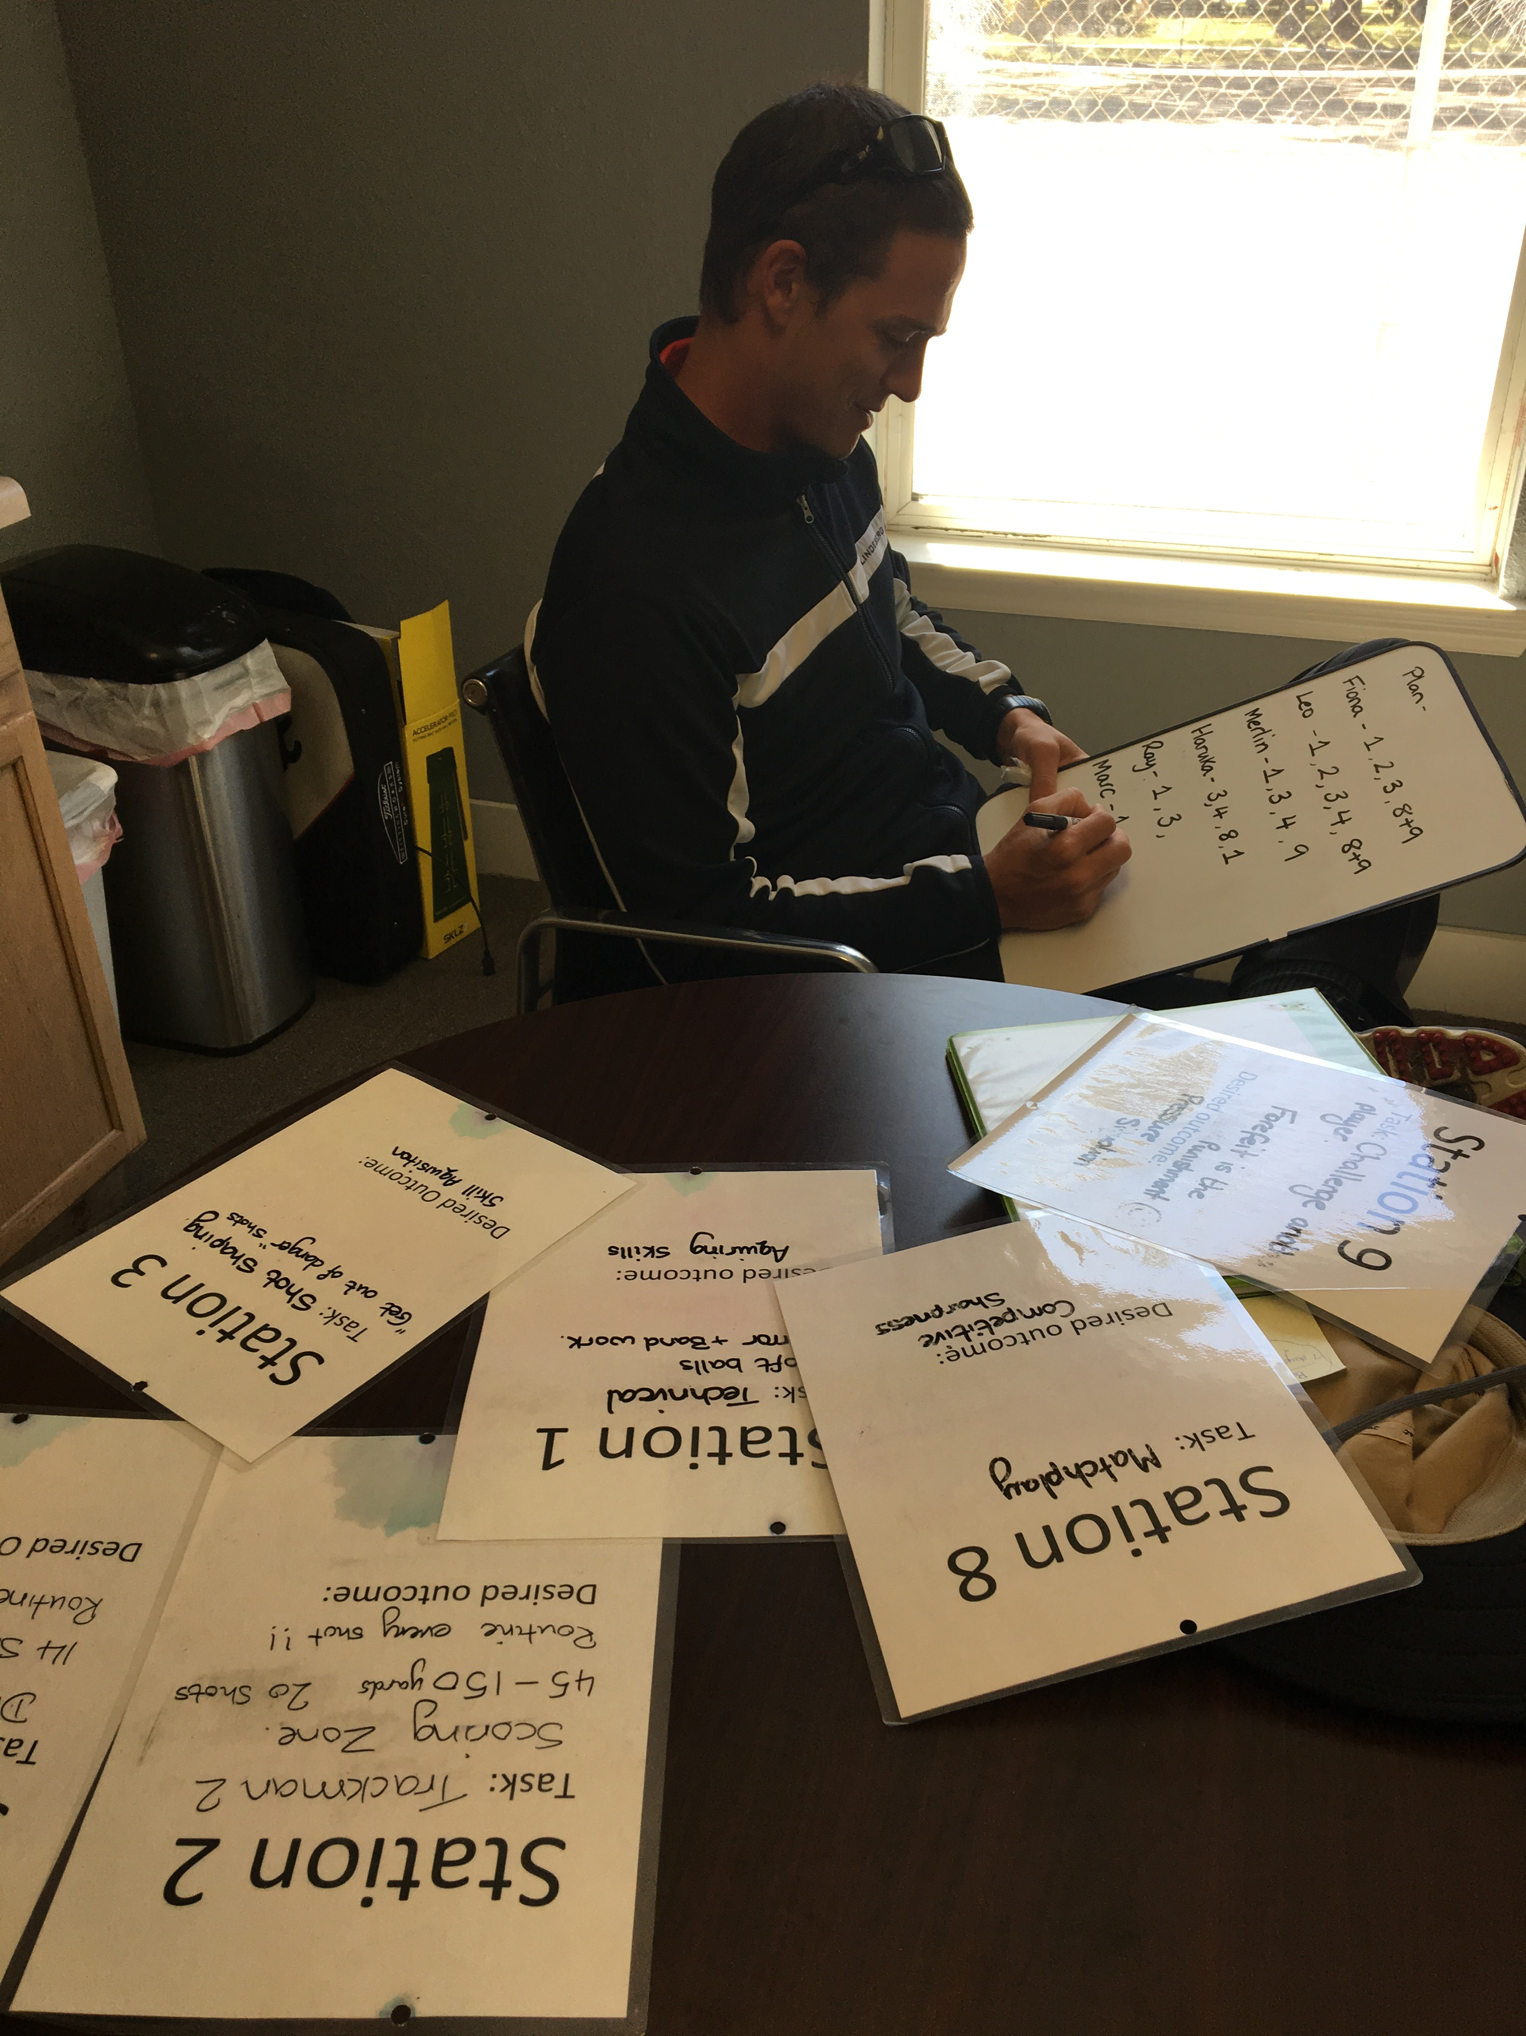
Plan
Have a plan
Plan each day, week and month

Slide 3
Modes of training
Train in different modes- Technical, blending and competitive
Practice in different ways- random, constraint, technical, interleaved

Slide 4
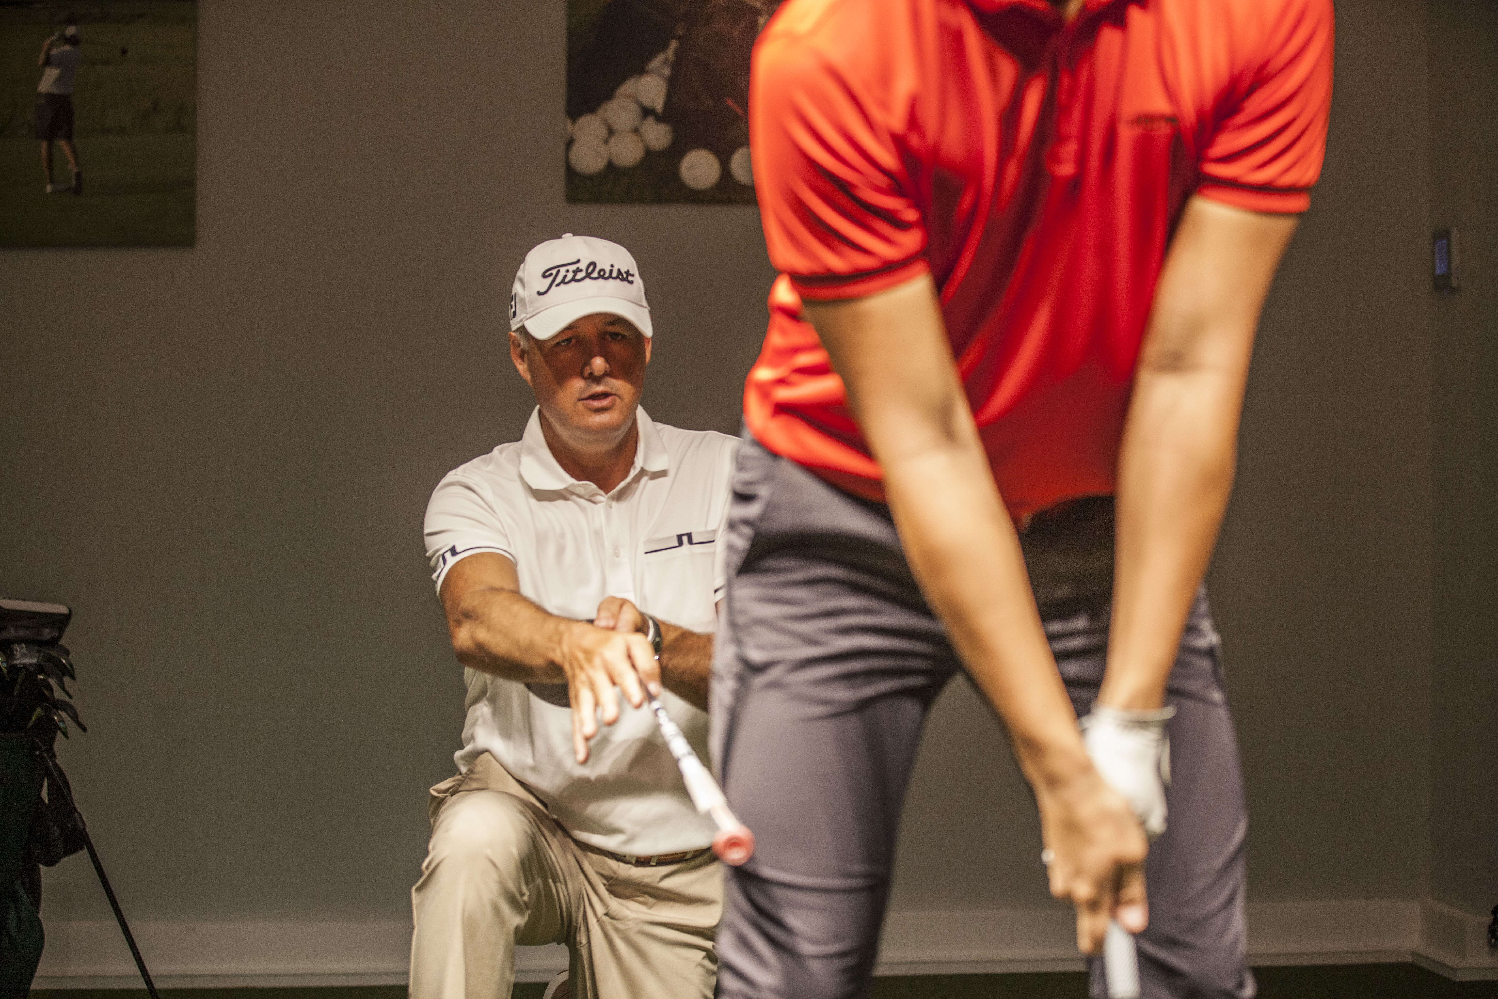
Technical competence
Control the ball
Be a great version of you
Far and straight
’Your swing needs to be good enough to control the ball, your short game does the scoring and your mind glues it together’

Slide 5
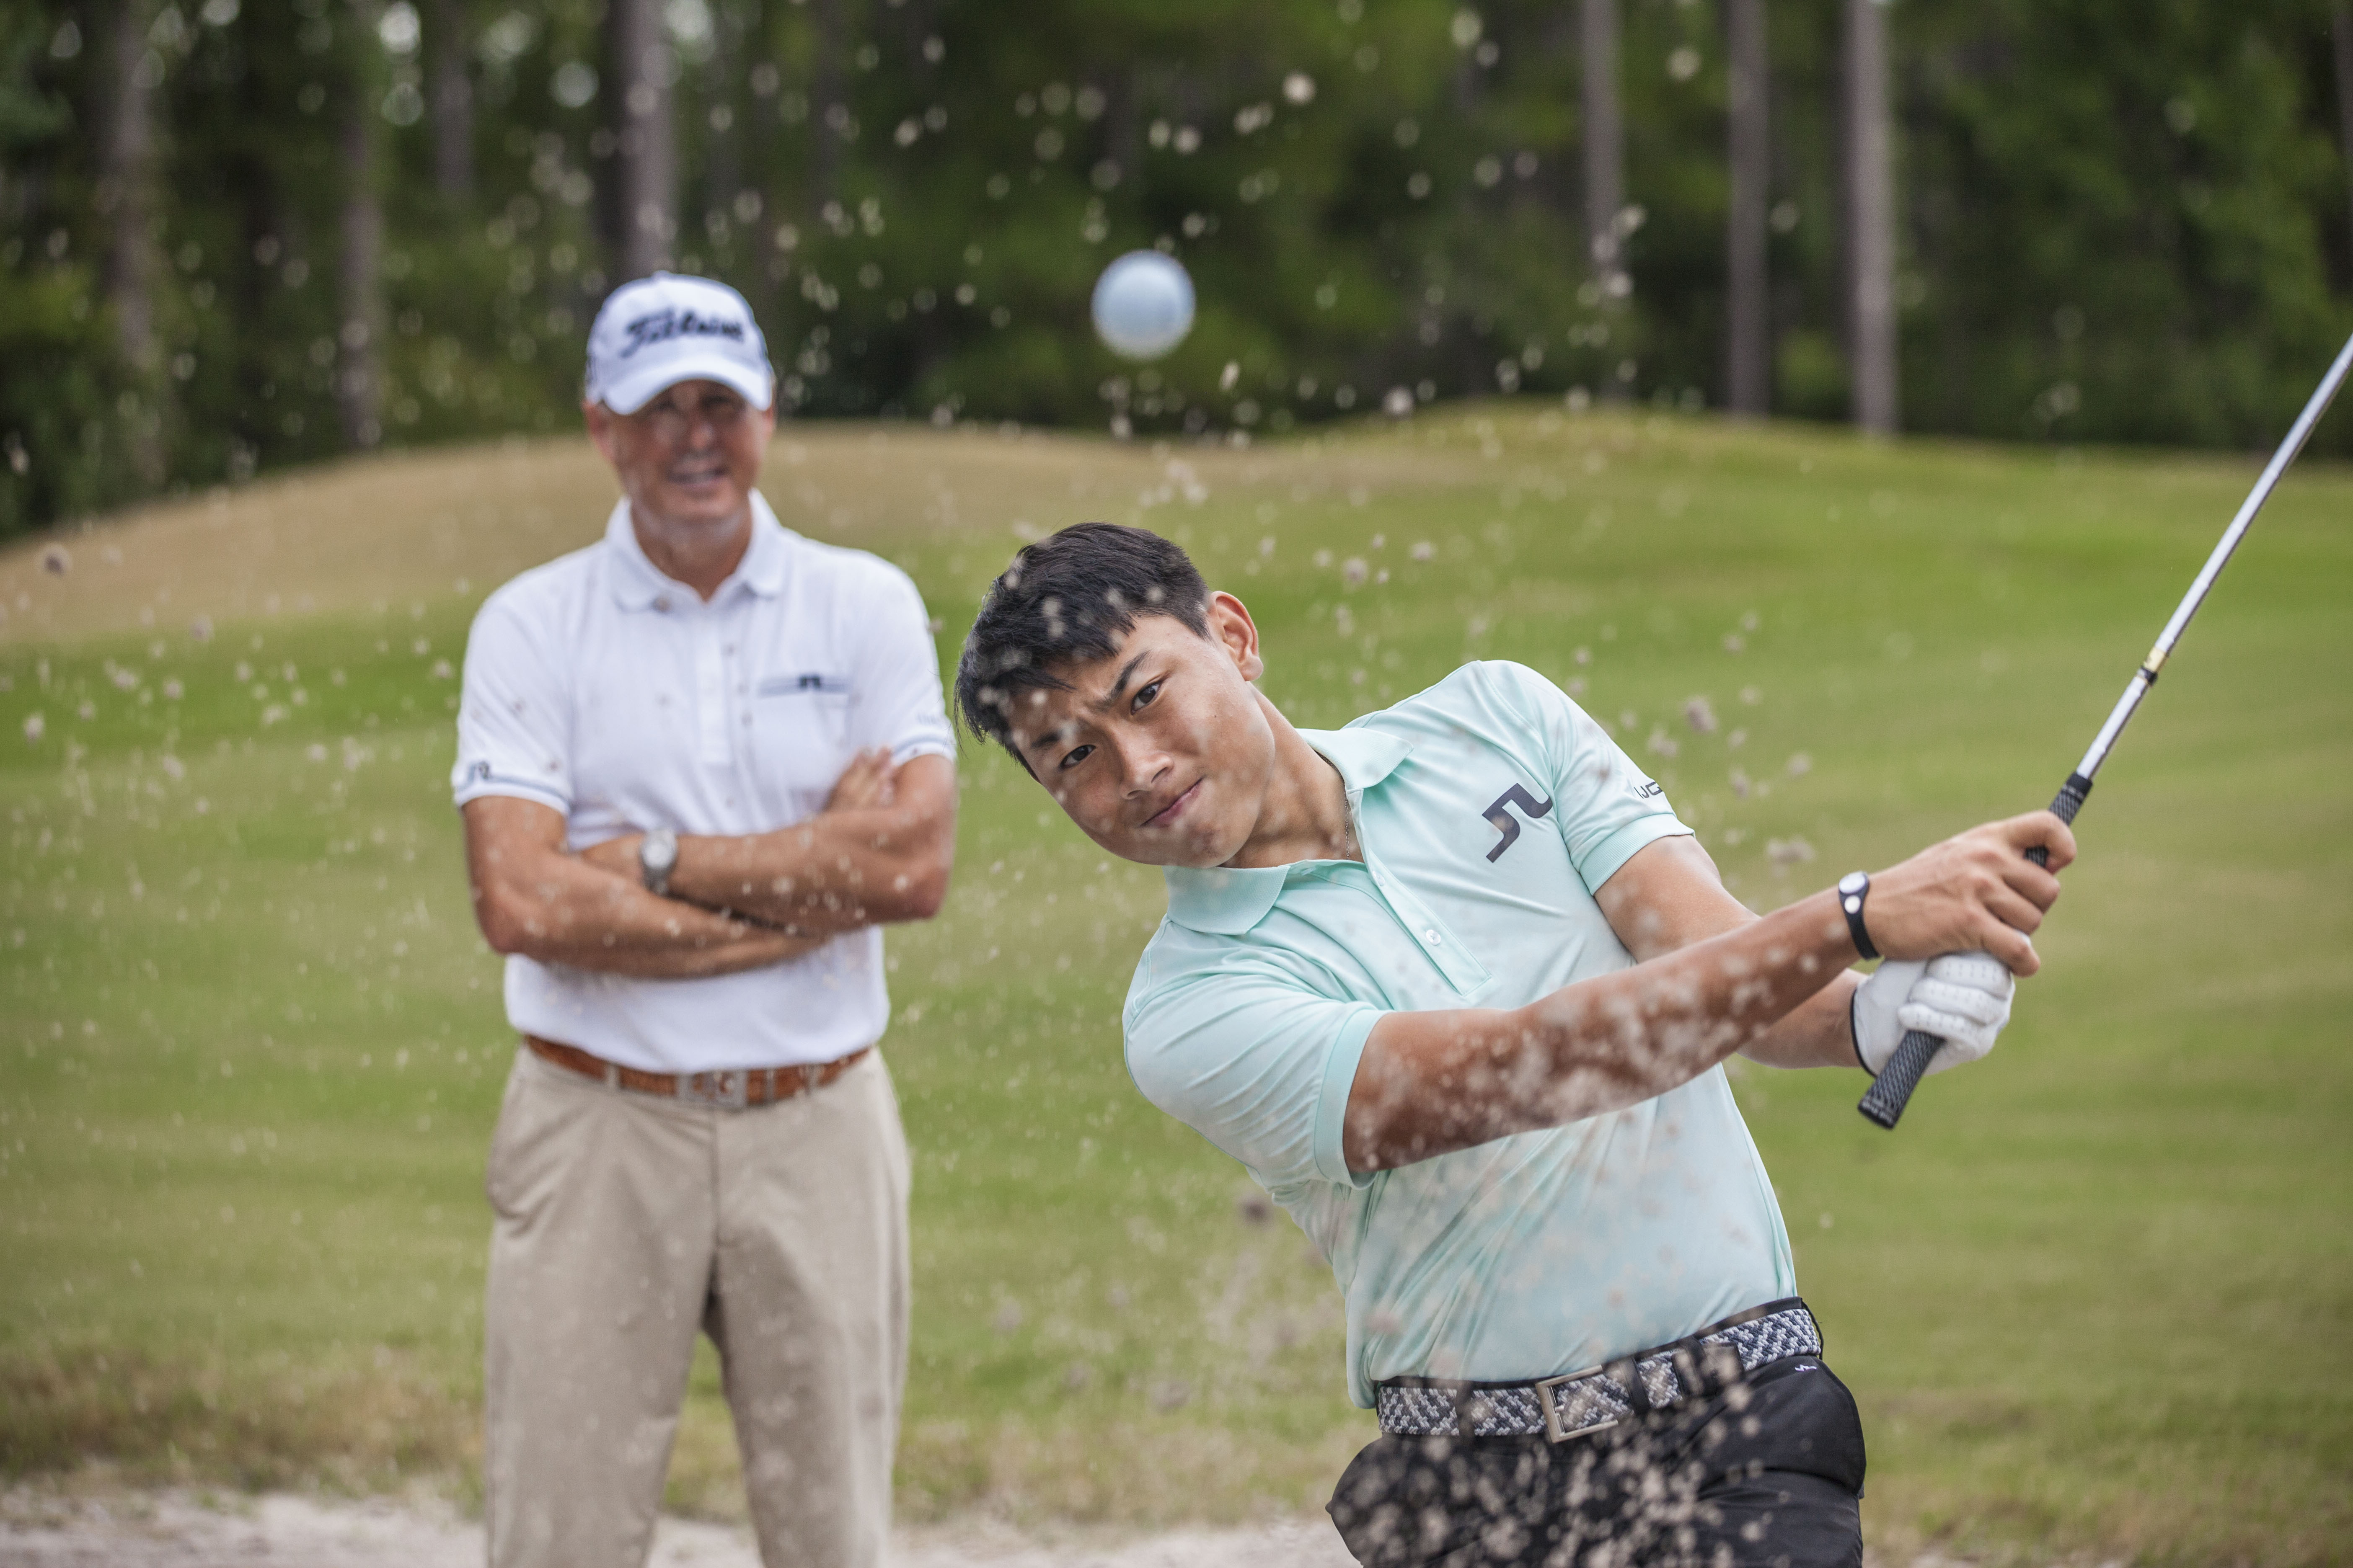
SHortgame
Tour quality putting
Tour quality short game
Pitching is key

Slide 6
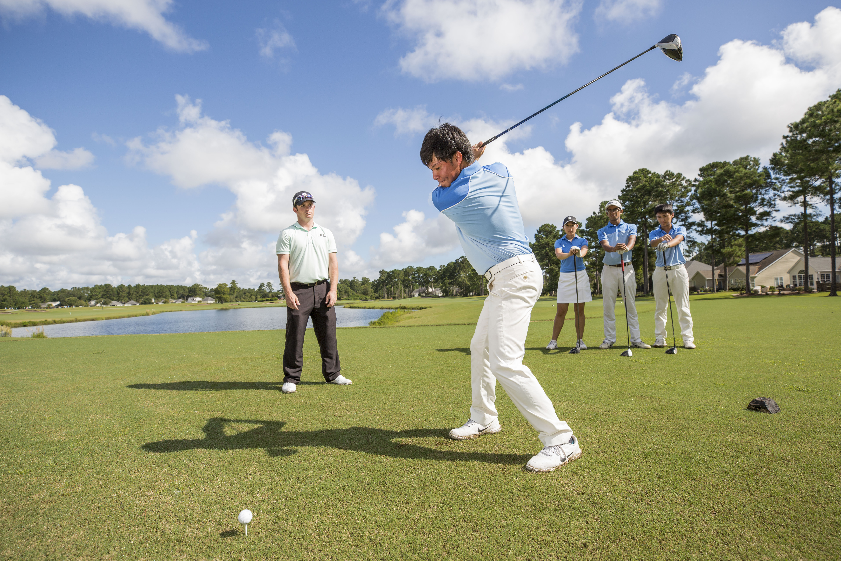
Play on a course
Play on the course
Problem solve
Focus on process not outcome
Do not let score define you

Slide 7
Have a course management system
Have a system of course management
Soft birdies
Birdies in the bank

Slide 8
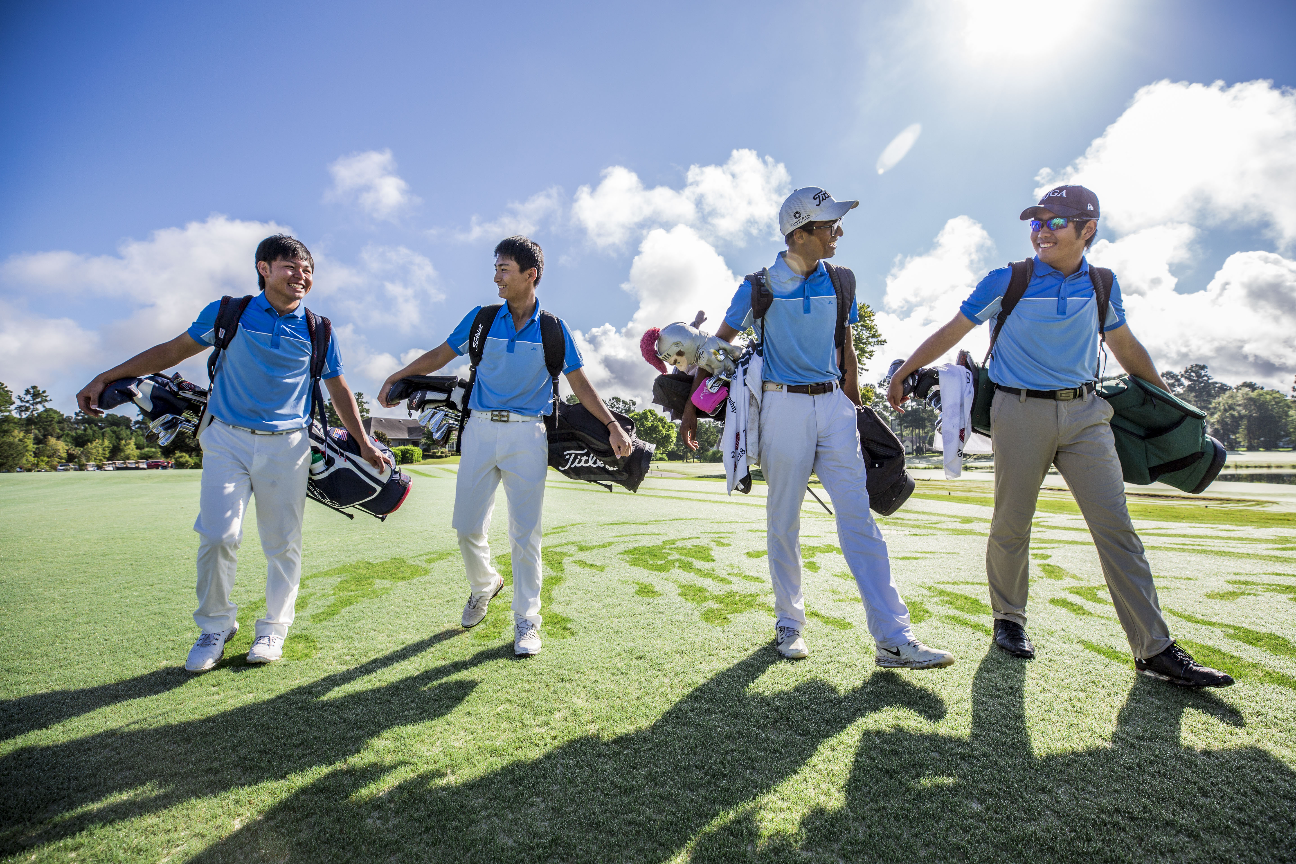
Compete
Golf is a game of failure
Enjoy competing
Accept the outcomes

Slide 9
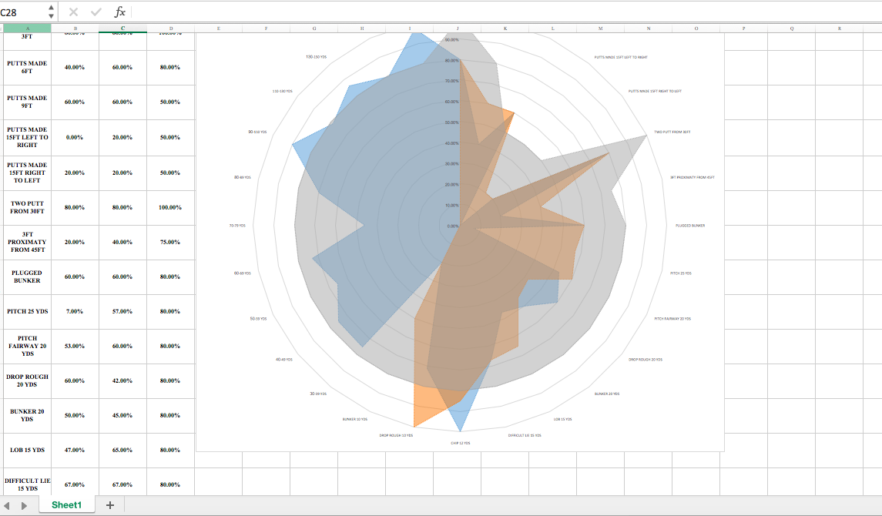
Measure progress
Stats
Measurable progress

Slide 10
Enjoy it
Enjoy the journey
Golf is like a painting that never gets finished!

