Slide 1
Training myths
Jonathan Yarwood

Slide 2
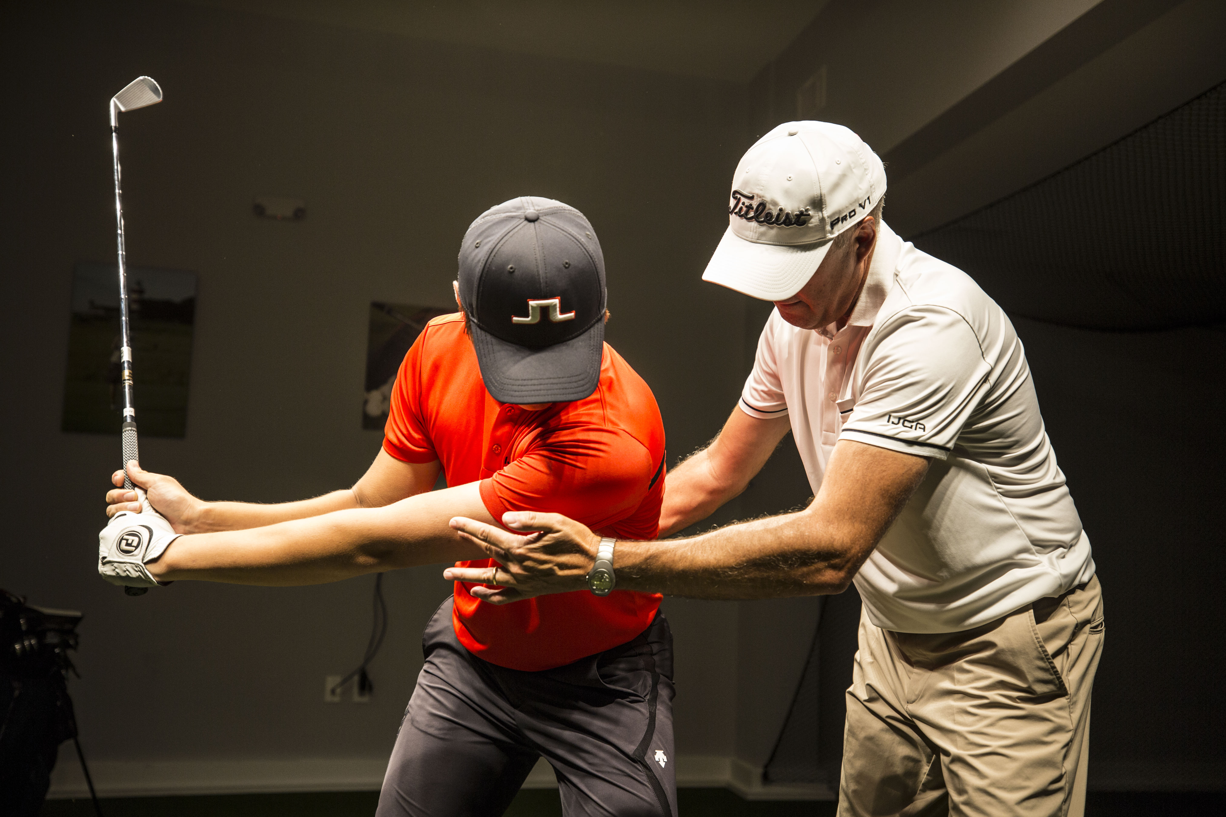
Work hard
Work smart
Quality not quantity
Rest cycle
Burn out
Long term development

Slide 3
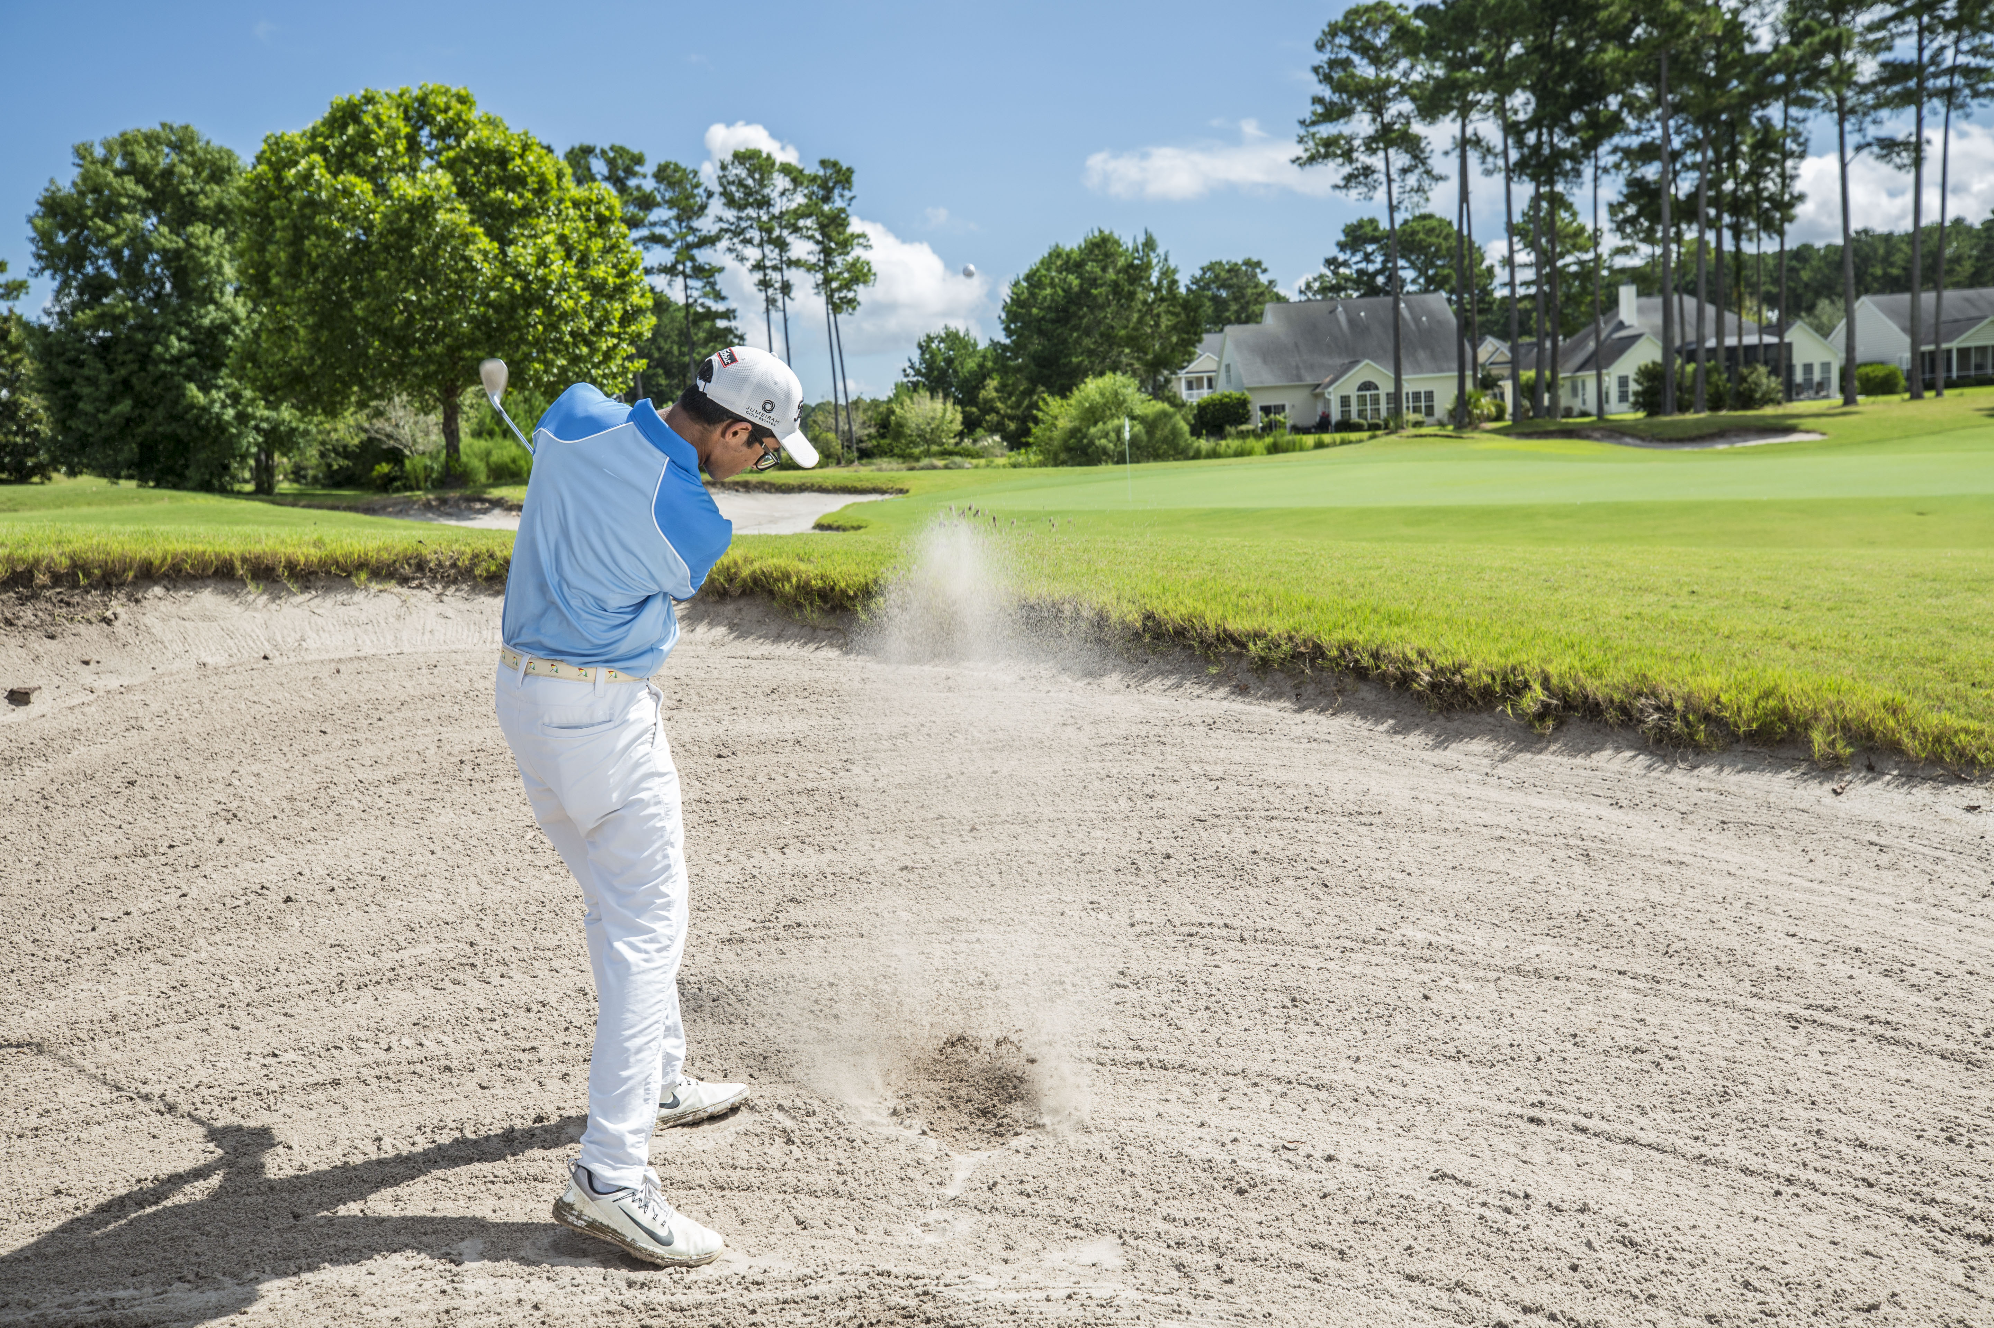
Score focus
Process
Skill Development not score
Skill mastery
Skill transfer
Outcome is good scores

Slide 4
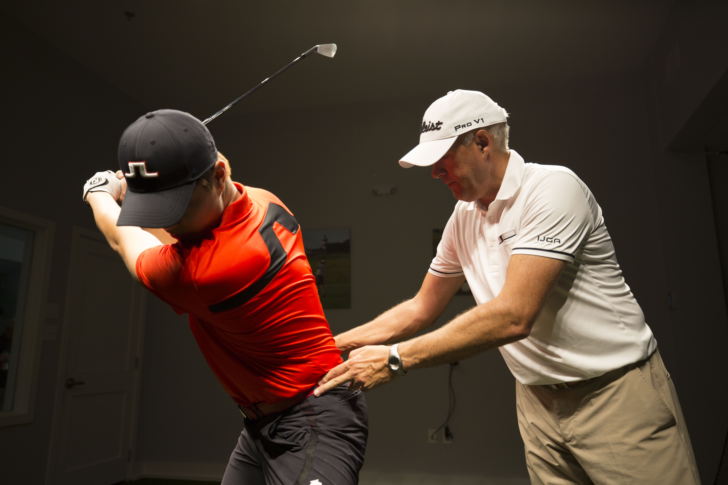
Technique
Ball control
Varied practice
Not robotic
Less balls
Art and science

Slide 5

Driving ranges only
Problem solving game in an ever changing environment
Go play
Enjoy the game

Slide 6

Fun
Have fun!
Love your kids no matter what

Slide 7

Golf is easy right?
Golf is cyclical
One day good, one day bad
Parents should play
Easy game to watch

Slide 8
They all Make it, right?
Not everyone makes it
It’s often the player that nobody notices that does best
Life lessons through golf
Skills through golf

