Slide 1


Slide 2

Hilton Head voted “Best Island” in the continental U.S. (2018, 2017, 2016) and #2 Island in the world – Travel + Leisure (2017)
“Best Small Town Top 10” – Southern Living 2017
Hilton Head ranked 7 in the 8 Top Categories for Golf Destinations – Golf Digest 2017
Bluffton voted “Most Picturesque Small Town in South Carolina” – USA Today 2017

Slide 3

GOLF ACADEMY
CHECK LIST
Corporate Structure is the foundation, and being a people business, a partnership the best structure.
Being financially solid is important, to reassure students of their future, as well as staff.
Outstanding golf program, with a stable team of highly motivated golf coaches.
Excellent academic program, with tutoring support for students.
Character/Leadership development, based in warm but strict housing environment.
See Appendix II for scorecard, compared to our perception of competitors.

Slide 4
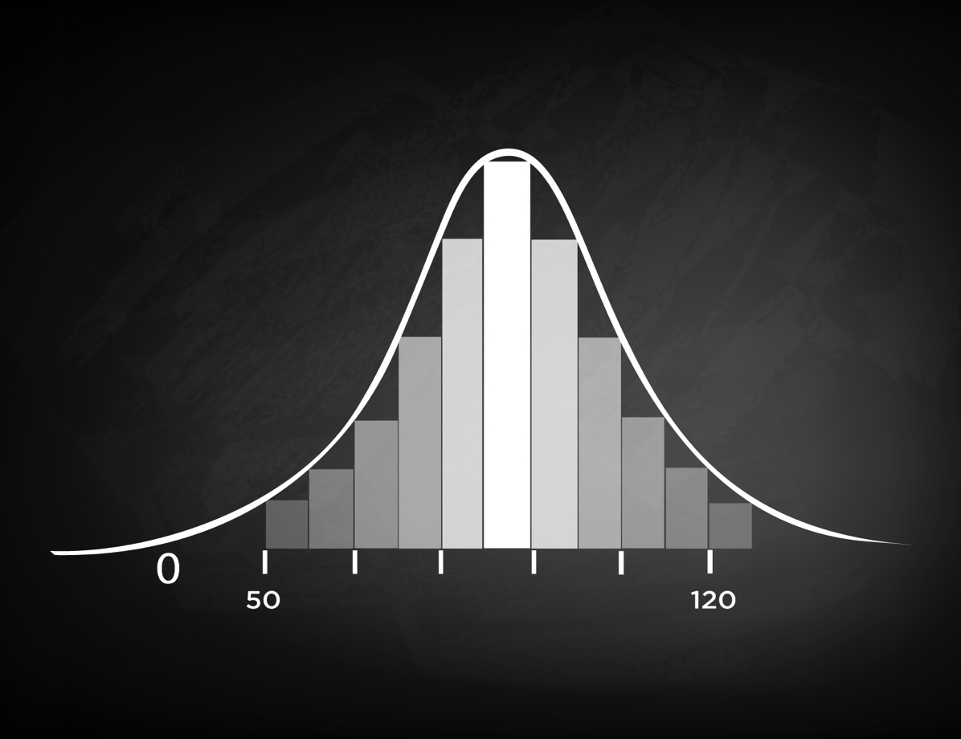
BUSINESS PHILOSOPHY
  At less than 50 students unlikely to have sufficient critical mass to afford full service in golf, housing and academics.
  Often structured as a sole member company, where senior staff don’t have an equity interest or decision making.
  At over 120 students very difficult to control the peer group of students to ensure focus on character development.
  Often structured as a corporation, with shareholders driven by financial return rather than a passion for the students.
  We believe that the ideal size is at about 100 students, to have sufficient financial resources to offer the full complement of services, to afford a campus environment and to control the development of character and leadership in students.
  Ideal if structured as a partnership, with senior staff having ownership and decision making, which is motivating.

Slide 5
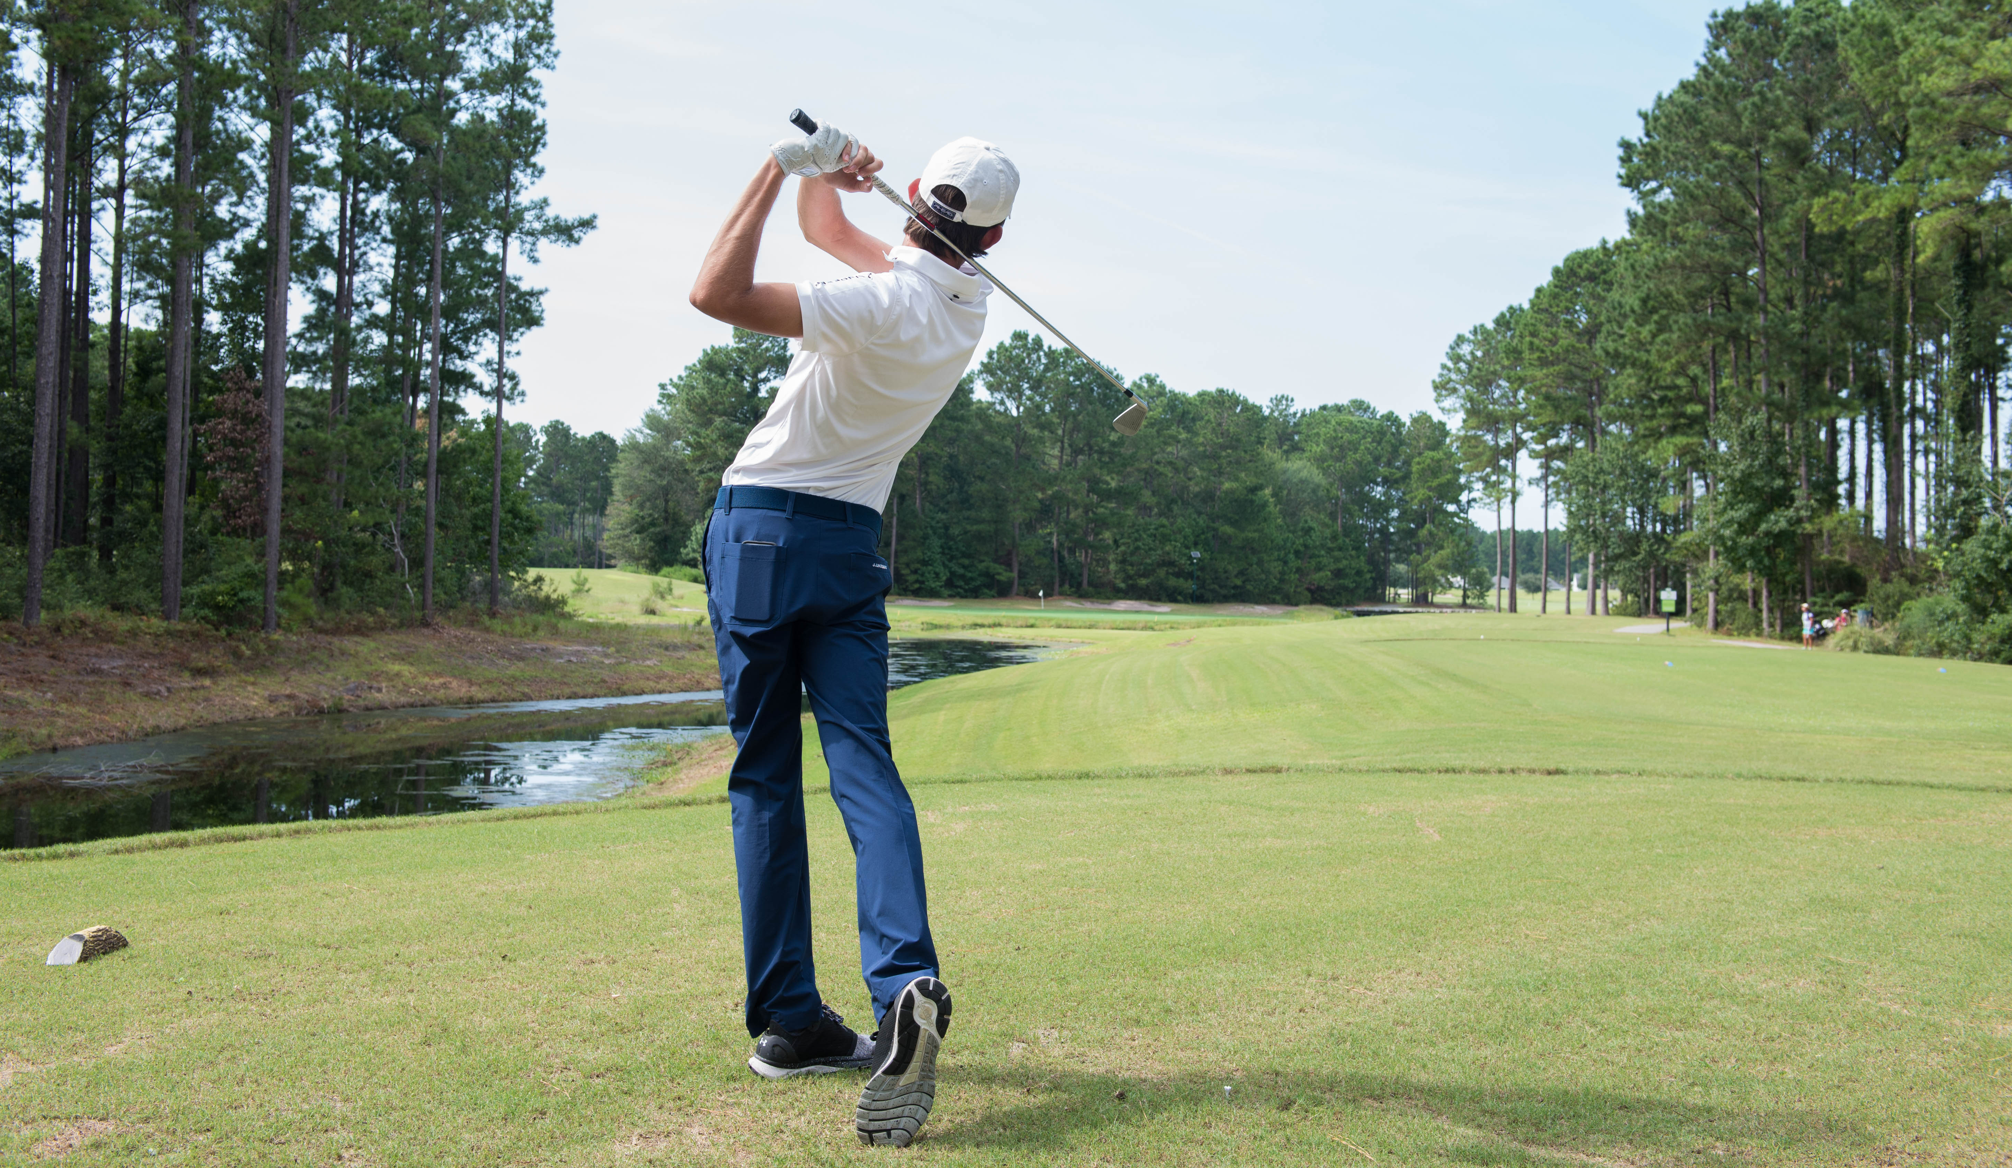
Under the direction of Director of Golf Jonathan Yarwood, a British Master PGA Professional with 25 years of experience and a proven history. Yarwood has coached a U.S. Open winner, two U.S. Amateur winners, two U.S. Girls winners, 3 AJGA players of the year, 4 #1 juniors, a male and female #1, a collegiate #1 and winners on six tours.
We have an excellent team of golf coaches with an unparalleled average experience in junior golf teaching, learning and coaching.
Structured in POD teams — with three PODS in total, each has its own coach. Small student-to-coach ratios allow for highly individualized training programs, specifically tailored to each student’s needs.
With an emphasis on the strategic selection of tournaments for competitive experience and to raise profile for college.
Exceptional in-house competition to develop enjoyment and confidence in competition, with easy access to weekend golf.
GOLF
PROGRAM

Slide 6
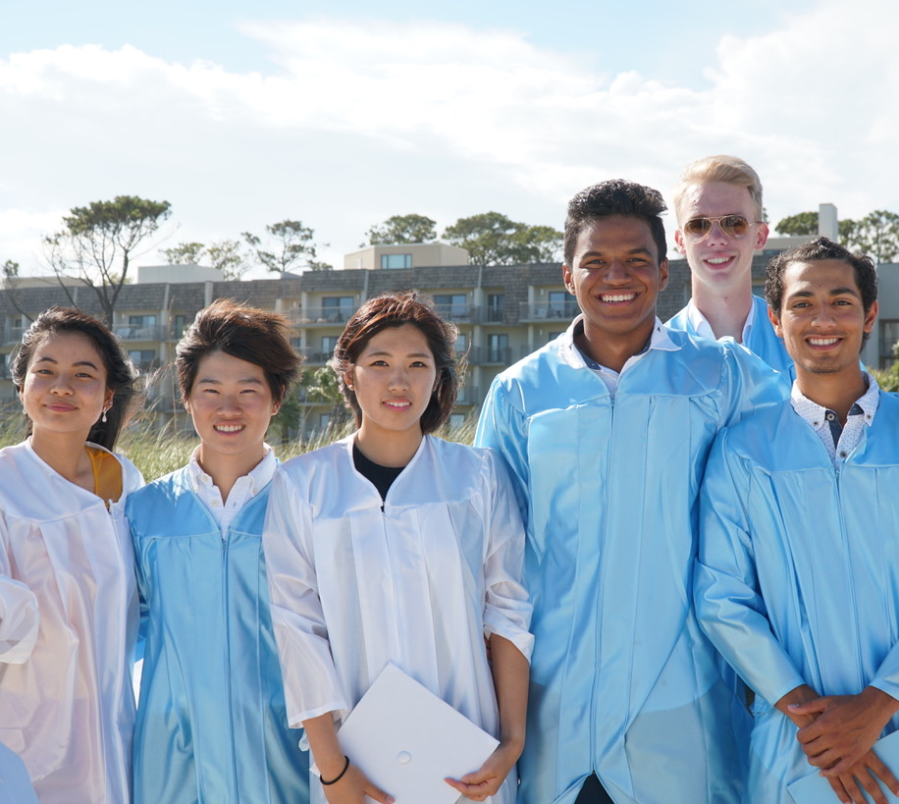
ACADEMIC PROGRAM
Our partner school is Heritage Academy, renowned for good academics and support of sports / passions.
Students may also choose to attend Hilton Head Preparatory School as an additional option to pursue their sports / passions.
Also partnering with tennis, golf, equestrian, basketball, swimming, rowing academies.
IJGA has its own Learning Center, providing the following services:
  - Study Hall, with tutors for students who
  need support with school work
  - Study Hall, as a quiet place for students
  who wish to study with peer group
  - Tutoring in a range of subjects, including
  English as a Second Language (ESL)
  - Tutoring in ACT, SAT and TOEFL

Slide 7

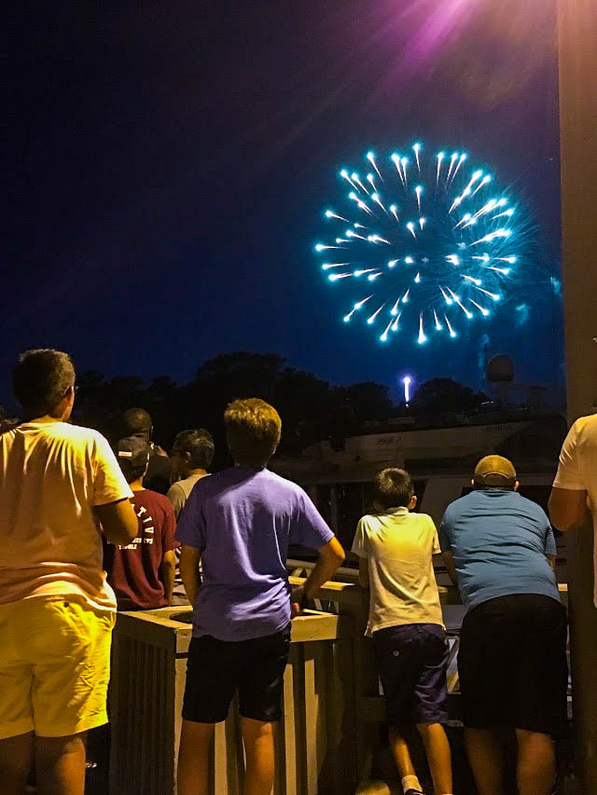
CHARACTER
COLLEGE
STUDENT LIFE
Developing character traits of Grit, Determination, Self-Esteem, Self-Confidence, Sociability.
We are exceptionally proud of our Peer Group, who share the common experience of making sacrifices in leaving home, often having the courage to study in a foreign country, in a foreign language, and having the ambition for greatness as a professional golfer or at least an outstanding college golf experience. The student influences on each other is amazing, and we manage this with light touch.
Senior students are elected as role model Captains and participate in fortnightly Leadership programs. All students participate in weekly Character sessions based on the college athlete Habitude program.
Extensive College Advisory and Placement service, starting from 8th grade in establishing goals, with students then guided in golf and academics towards achieving these goals, with parents and students expectations managed carefully throughout.

Slide 8
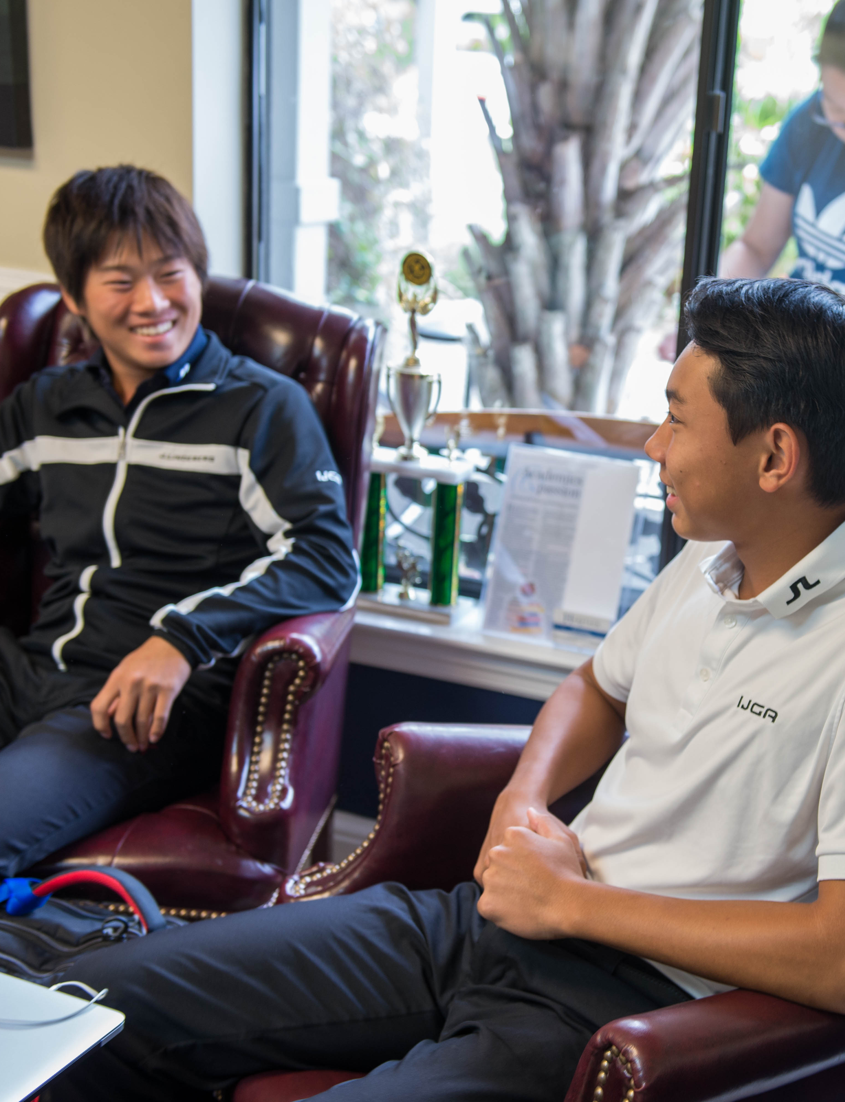
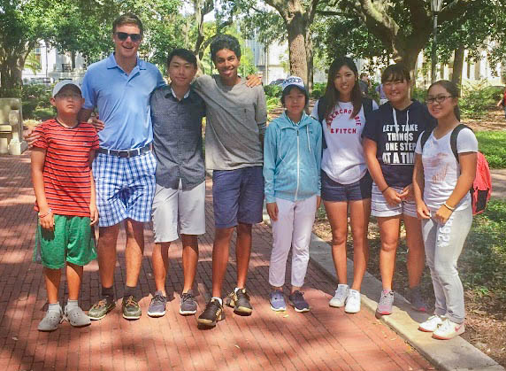
Our College Advisory team work with an extensive network of College Golf Coaches, providing options to students and supporting them in their applications, communication and visits with colleges.
Students are housed in private condos and homes, creating a “home away from home” environment, in a gated community, and are supervised and supported by a mix of experienced residential instructors.
With regular input from the students, residential instructors organize extensive weekend activities for students to select from such as kayaking, bowling, zip lining, parasailing, mini-golf, paintball, laser tag, rollerskating, dolphin cruises or a trip to the beach.
CHARACTER
COLLEGE
STUDENT LIFE

Slide 9
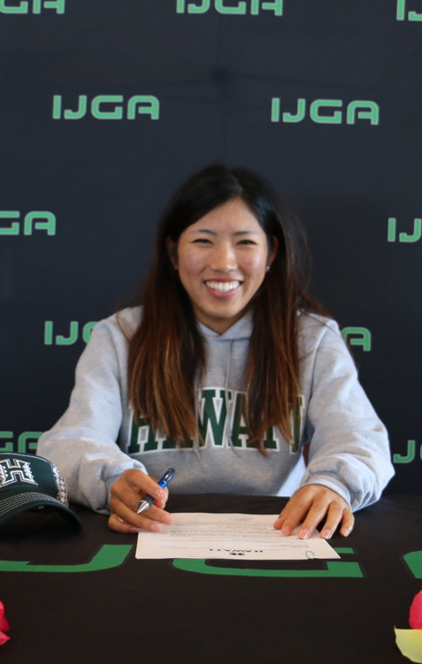
STUDENT OUTCOMES
Nearly all Academy and Post Grad students gain university scholarships to play college golf.
Although we cannot guarantee this performance, as very much down to each individual.
For over twenty years, students from around the world have come here to learn the same methods that have helped some of the best players on the PGA and LPGA Tour. Notable alumni who have attended IJGA include Shanshan Feng, I.K.Kim, Richy Werenski, Maria Jo Uribe, Pablo Larrazabal, Morgan Hoffman and many more.
See Appendix I of notable college and golf successes
Although not measurable, our true measure of success is in developing fine young people, well prepared for life and college, with strong values and a good golf game, for many years of enjoyment with friends.

Slide 10
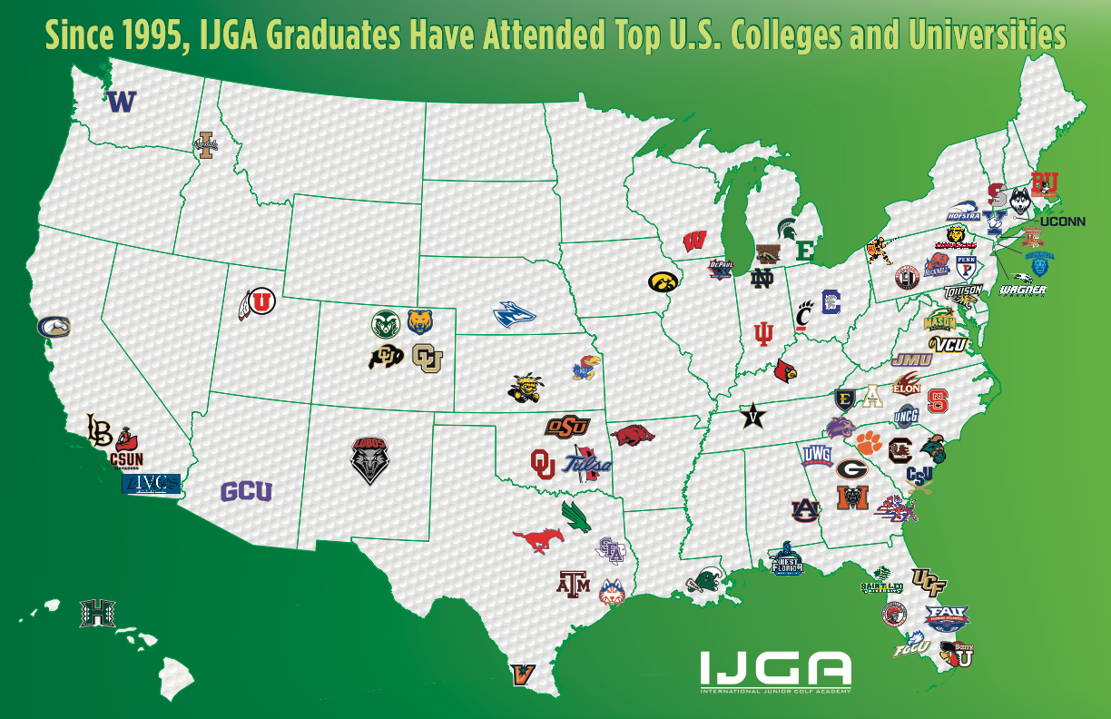
STUDENT SUCCESSES
GOLF many touring golf professionals:
MEN: Richy Werenski, Morgan Hoffman, Pablo Larrazabal
WOMEN: Shanshan Feng, Maria Uribe, Stephanie Meadows
COLLEGE
2015 - 20 Graduates, 18 went onto college, 16 Scholarships
(9 to D1, 5 to D2, 2 to D3), 2 students went onto a PG year
2016 - 13 Graduates, 12 went onto college, 11 Scholarships (6 to D1,2
to D2, 1 to D3, 2 to Other)
1 went onto a PG year
2017 - 28 Graduates, 18 went onto college, 15 Scholarships
(12 to D1, 3 to D2 and 2 to NAIA)
2018 – 6 Graduates, 6 went onto college, 4 Scholarships (2 to D2)

Slide 11

COMPETITOR CHECK-LIST
APPENDIX II
(5 high 1 low) |  | IJGA | BGGA | COMP 1 | COMP 2 | COMP 3
Corporate Structure |  | 5 | 5 | 2 | 2 | 2
Financial Stability |  | 4 | 4 | 5 | 2 | 2
Golf Program |  | 5 | 5 | 3 | 3 | 2
Academic Program |  | 5 | 5 | 1 | 4 | 3
Character Program |  | 5 | 5 | 4 | 2 | 2
TOTAL |  | 24 | 24 | 15 | 13 | 11
Note: Our point awards are subjective, and based on our outsider perceptions

Slide 12
FINANCIALS
APPENDIX III
    Golf Academy Fees:
    $58,500 + $1,950 (transport fee/uniform) = $60,450
        (inclusive of golf program, housing, catering)
        - With individual golf lessons, psychology and mental sessions, fitness, study hall tutoring
        - But additional costs for golf equipment, requested tutoring, mandatory study hall
        - As well as clothing apparel, school transportation and various personal services
School Fees:
Approximately $15,500, but some variation according to grades and requirements
    Tournament Fees:
    Between $4,000 and $10,000 depending on number and quality of events
  Other:
  Incidental expenses for weekend activities
  With spending money for golf supplies, meals when off premises etc.
    TOTAL:
    Between $80,000 and $90,000, but with a decent expectation of earning a significant college scholarship, acting as an offset of this investment in child, as well as of course the invaluable, immeasurable, development of child

Slide 13

NOTABLE ALUMNI
Students train and play on Pinecrest Golf Club and other Hilton Head/Bluffton courses.
Renovating our practice facility to be of PGA Tour standards.

Slide 14
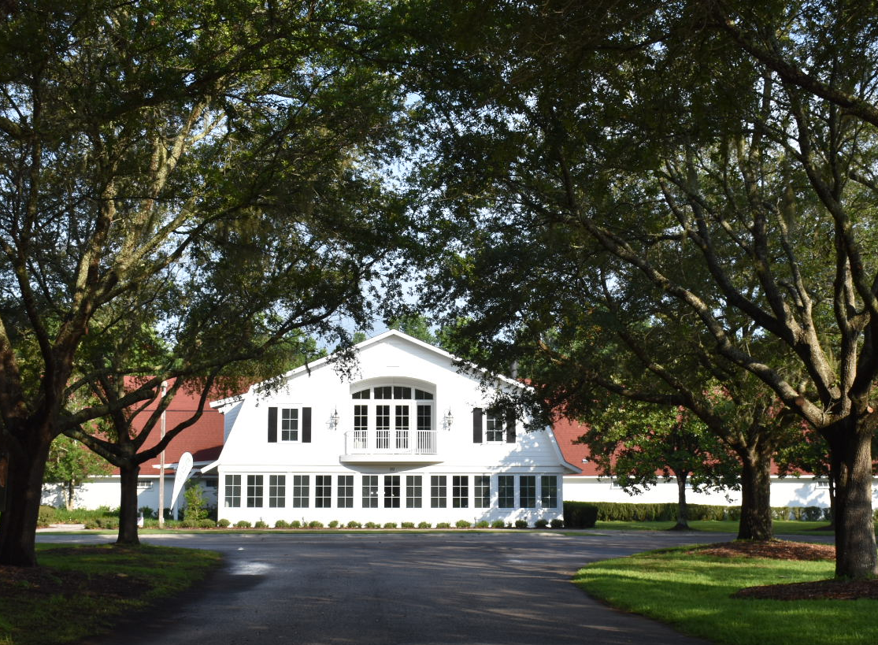
“NEW” OLD CAROLINA CAMPUS
Centralized campus on 150-acres within a gated community.
$2 million renovation recently completed on the 20,000 sq. ft. Indoor Performance Training Center.
Recreation/Lounge Area
Performance Fitness Center
FUEL Dining Hall
Learning Center
Par-3 Challenge Course, Himalayas & 9-hole putting green.
Housing for female student-athletes
Onsite offices for coaches, administration and student life.

Slide 15
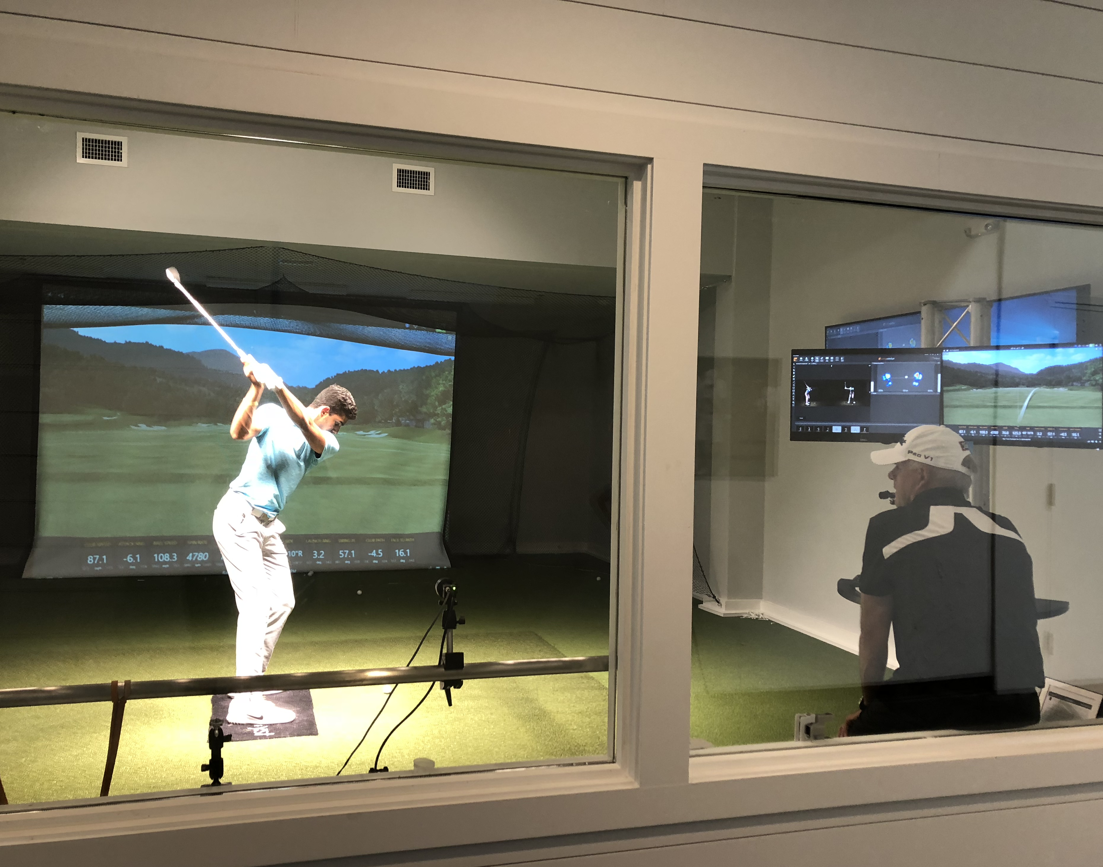
ON-SITE AMENITIES – INDOOR TRAINING
PERFORMANCE TRAINING CENTER
Swing Catalyst 3D Motion Plate & Studio, only one of two junior golf academies in the world to install the swing analysis system.
Indoor hitting bays with state-of-the-art technology including Trackman, K-Vest, BodiTrak, VI Video and more.
Indoor chipping and putting area, featuring the SAM PuttLab system.
Large recreation center complete with lounge area and games for student-athletes to congregate and sharpen their competitive skills.
Learning Center for study hall, tutoring and support of ESL, SAT and ACT.

Slide 16
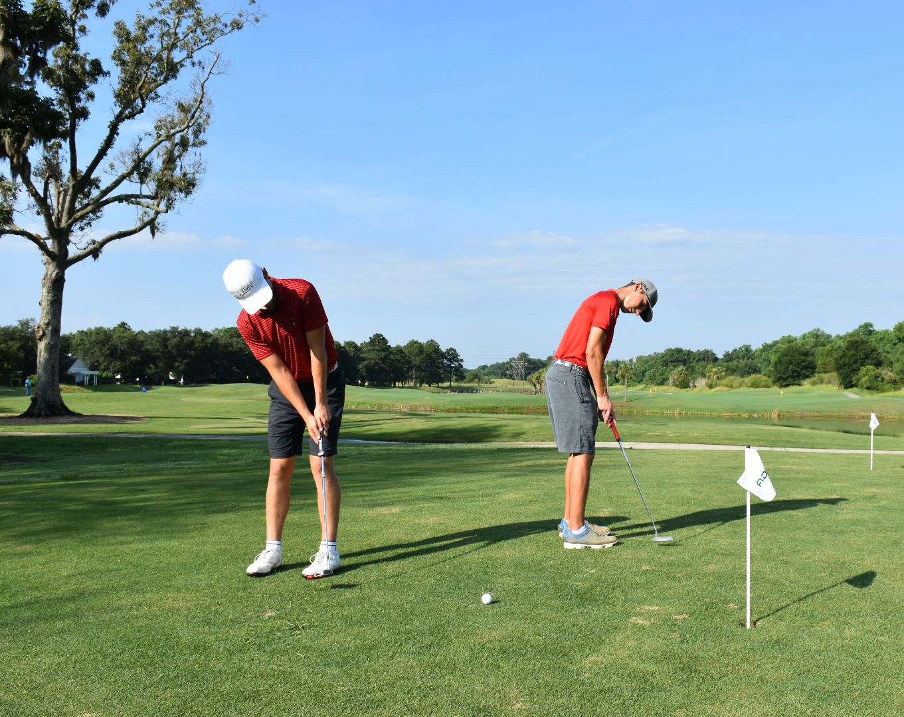
ON-SITE AMENITIES – OUTDOOR TRAINING
CHALLENGE COURSE & HIMALAYAS
Steps away from the IJGA Performance Training Center is the new Par-3, Challenge Course. Students can sharpen their iron making shots and short game skills on the course.
The rolling Himalayas provide students with an area to hone their short game skills with clearly defined targets.
The 9-hole large putting green adjacent to the Himalayas is the size of Harbour Town Golf Links’ 18th green. Ideal for the student-athlete who is focused on improving their putting stroke.

Slide 17

PERFORMANCE FITNESS TRAINING
PERFORMANCE FITNESS CENTER
Physical Strength and Conditioning – Flexibility and Mobility, Core Strengthening, Strength Training, Balance Work, Aerobic and Anaerobic Training, Yoga and Pilates
Mental Training - A science and fact based approach to identify the friction points to an individual’s progress – in the classroom, on the training tee and in tournaments.
Nutrition & Health – Students are educated in the importance of good nutrition for building and maintaining their strength.

Slide 18
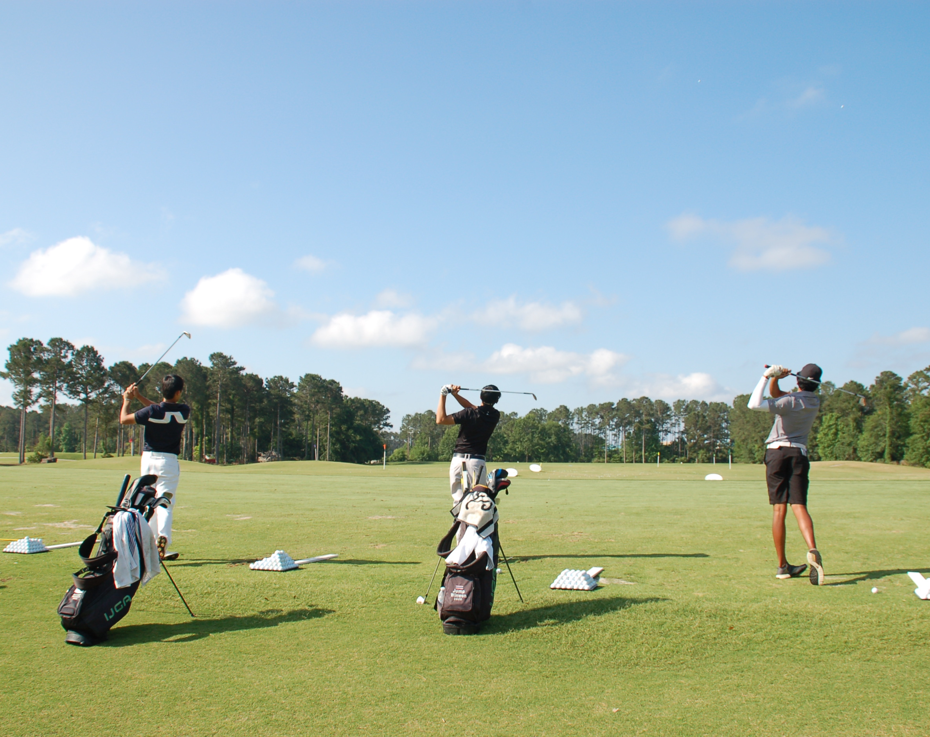
PINECREST GOLF CLUB
PINECREST GOLF CLUB IS IJGA’S HOME COURSE
Less than one-mile from campus, IJGA student-athletes practice on the newly expanded Pinecrest Driving Range and 18-hole manicured course.
Exclusive and expanded range for IJGA students.
Newly enlarged short game facility for chipping, putting and bunker work.
Only the best high-quality Titleist range balls.
Clubhouse access.

Slide 19
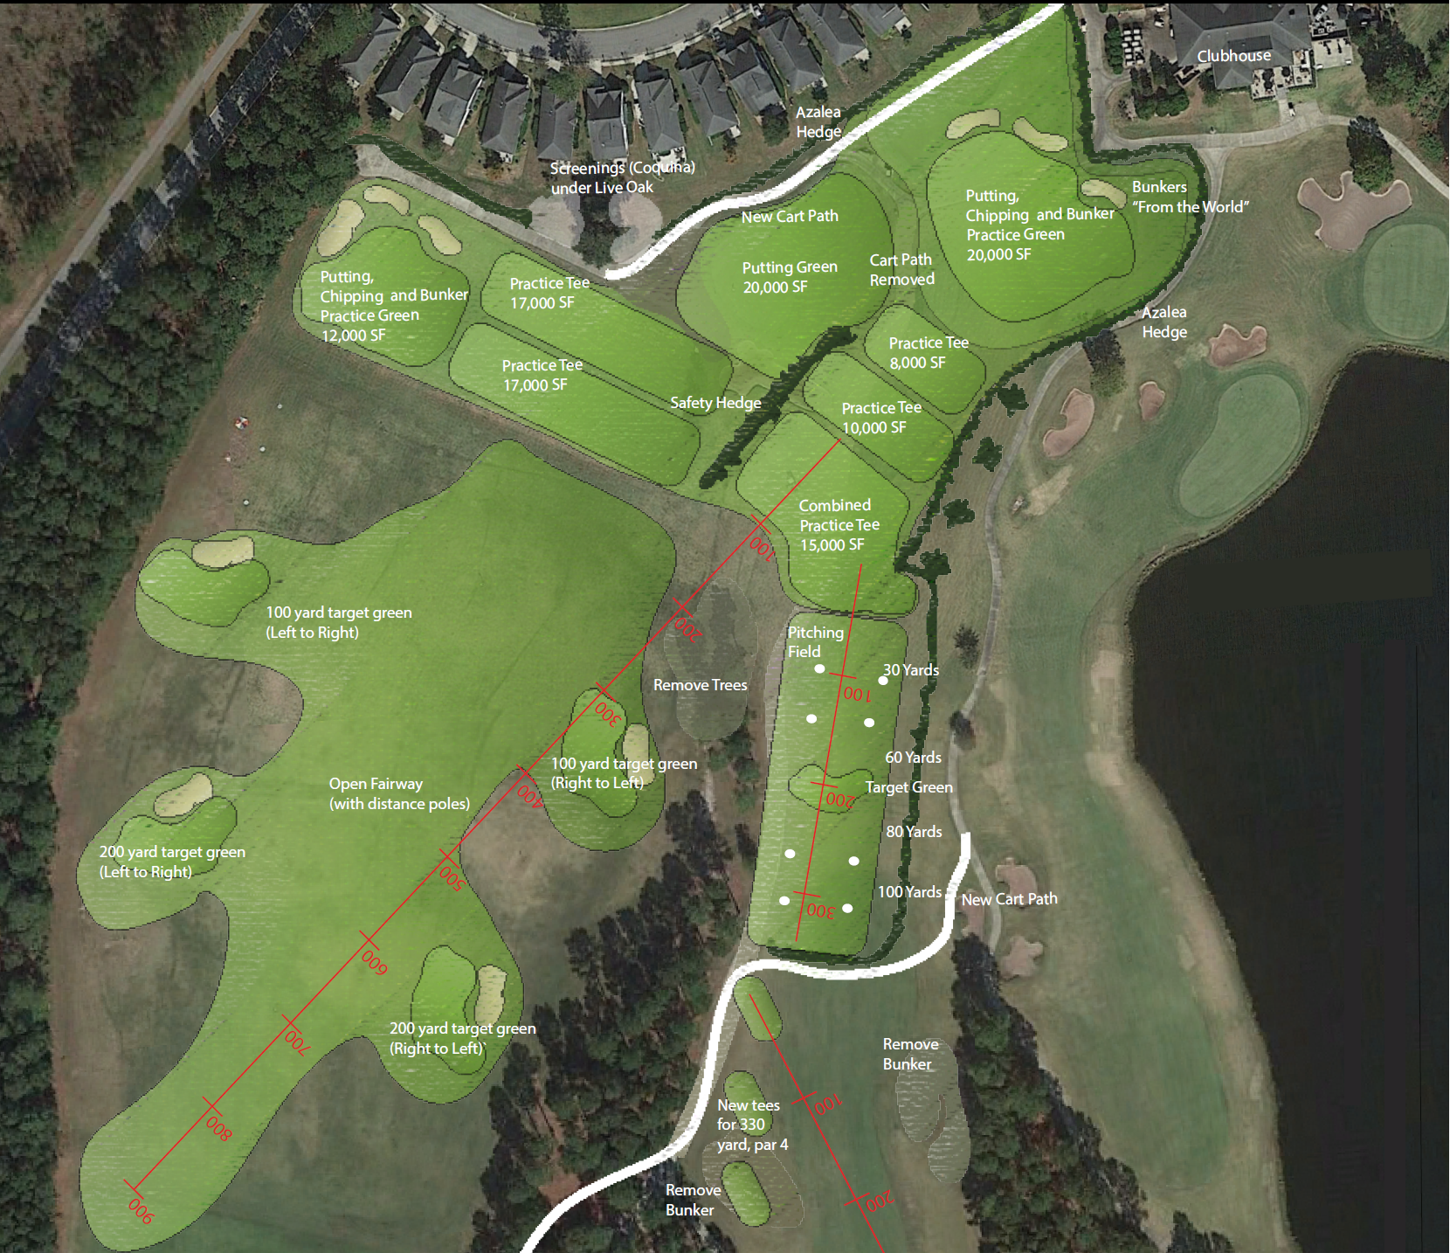

Slide 20
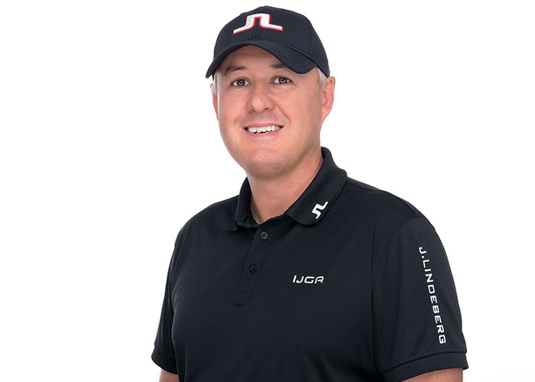
COACHING TEAM
Jonathan Yarwood – 25 year tour coach and British PGA Master Professional.
Trained a U.S. Open winner, two U.S. Amateur winners, two U.S. Girls’ winners, three AJGA Players of the Year, four #1 juniors, winners on the PGA, LPGA, European, Challenge, Asian and Australasian tours.
He has trained student-athletes of 11 years of age until they ultimately reached the tour.

Slide 21
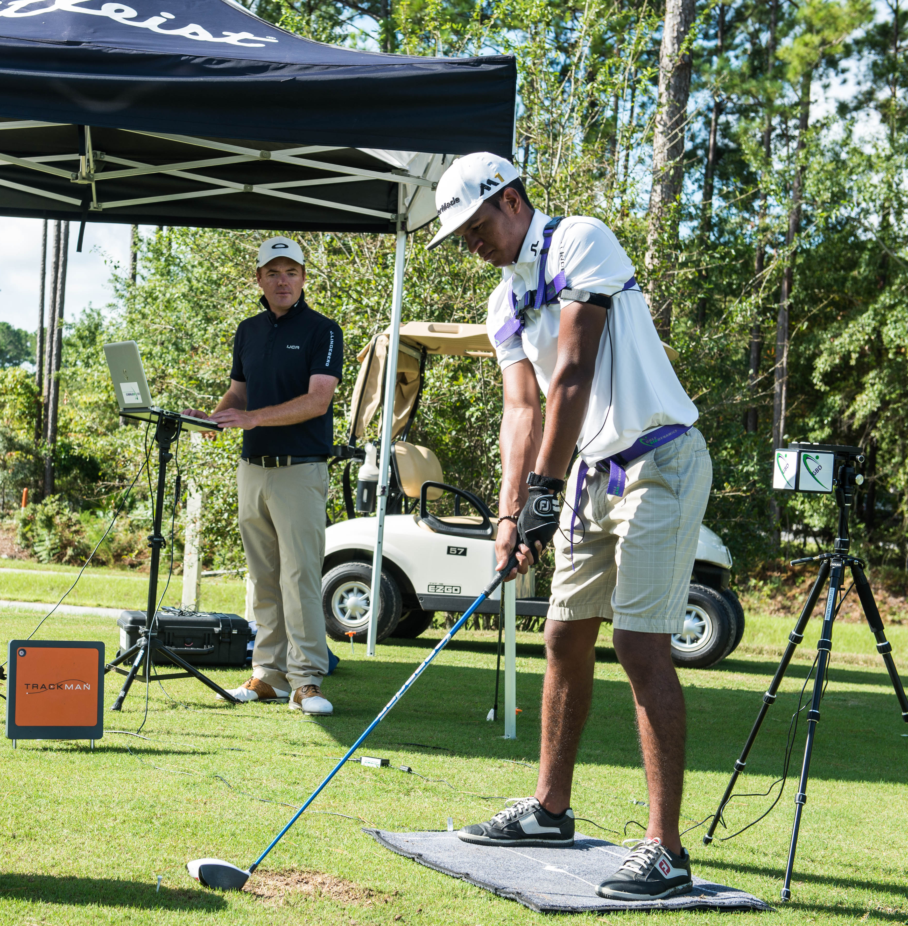
ATHLETIC DEVELOPMENT
Periodized training model to provide each individual student athlete with exactly the plan that they need.
Ongoing and comprehensive model of assessments, training, performance and evaluation.
Integration of all aspects of human
development: physical, mental, technical,
strategic and personal growth.
Program is built uniquely for every individual based on their goals, aspirations, tournament schedule, strengths and areas of improvement.

Slide 22
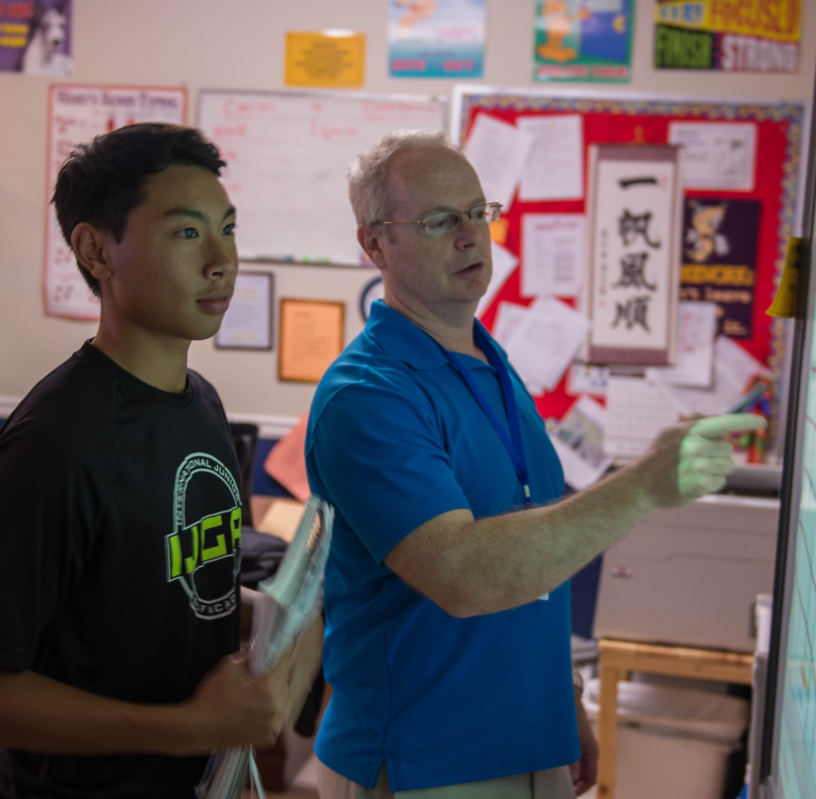

The jewel in the crown of IJGA.
School specifically for students with a passion.
Grades 7th – 12th.
Small class size with average of 10 and maximum of 15.
Classes can be taken as College Prep, Honors, and Advanced Placement Classes.
Diverse international student population.
Past students have gone on to attend some of the best academic schools in the U.S. such as Princeton, Yale, Columbia and Duke.

Slide 23
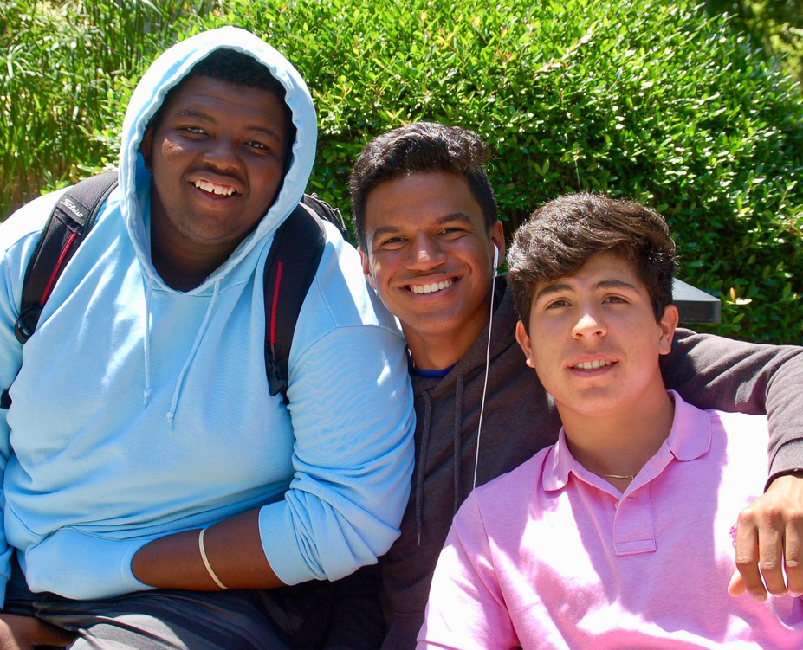
PROGRAMS
ACADEMY PROGRAM
Half Day Golf Coaching Training (3.5 hours per day)
Unlimited Golf Facility Access
Golf Specific Physical Fitness Training
Mental Training Program
Strategy & Performance Coaching
Full Tournament Schedule
College Preparation (SAT, Toefl, ACT)
College Planning & Placement
Character and Leadership Development
  IJGA is a Golf Boarding School

Slide 24
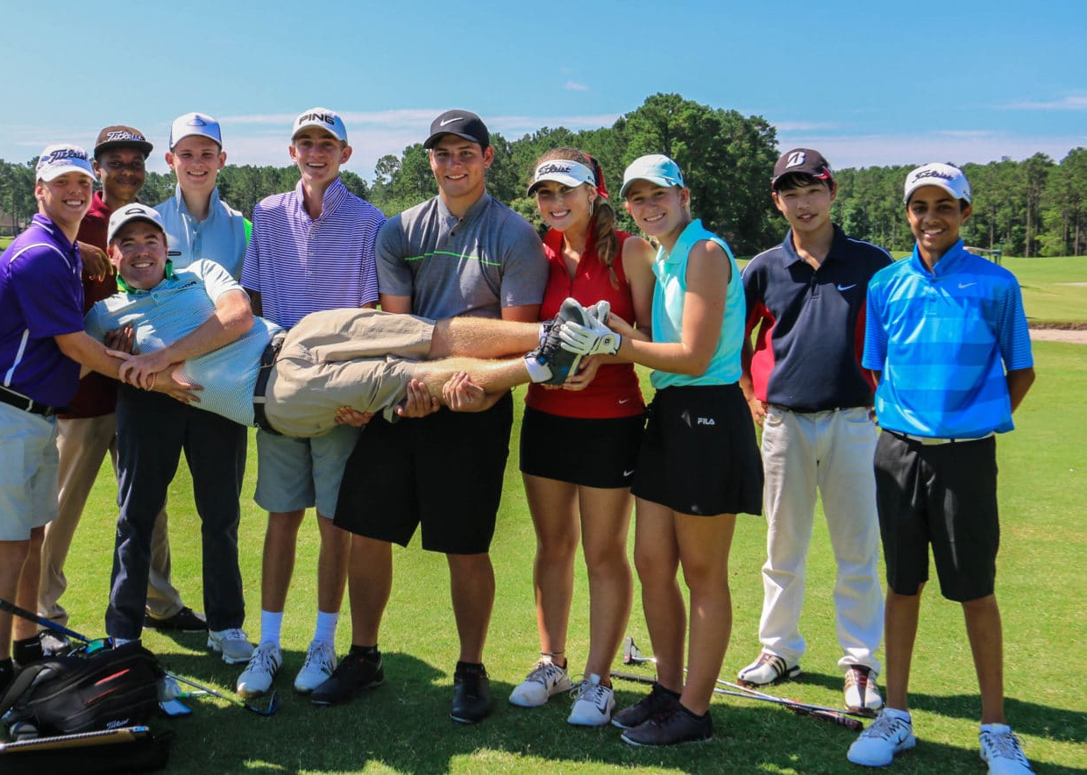
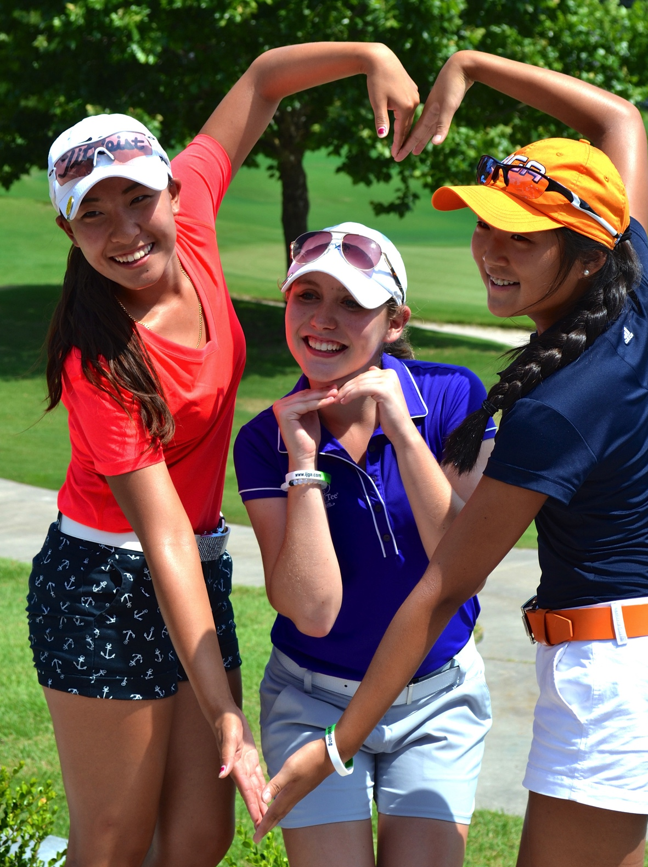
PROGRAMS
CAMP
Golf Training: Core and Elite
Fun Camp Activities on and off
Campus & Attractions
Physical Strength and Conditioning
An introduction to the Mental Training Program
On-Course Performance Coaching

Slide 25
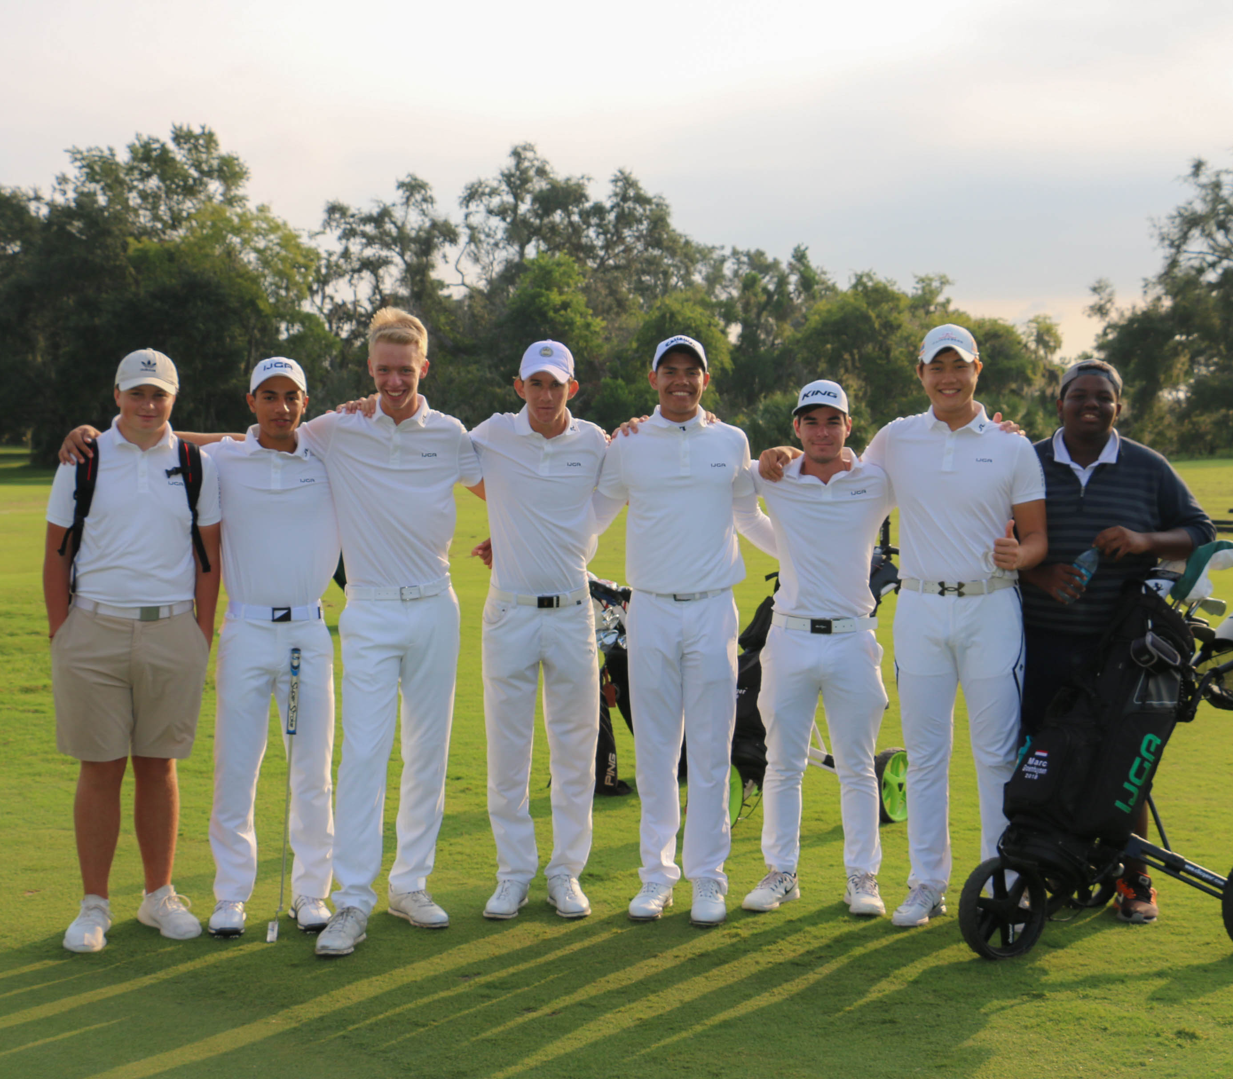
TOURNAMENT COMPETITION
Strategically designed tournament schedule to maximize opportunity to gain experience and exposure to college coaches.
Improve rankings.
Build confidence in competition.
Position for success.

Slide 26
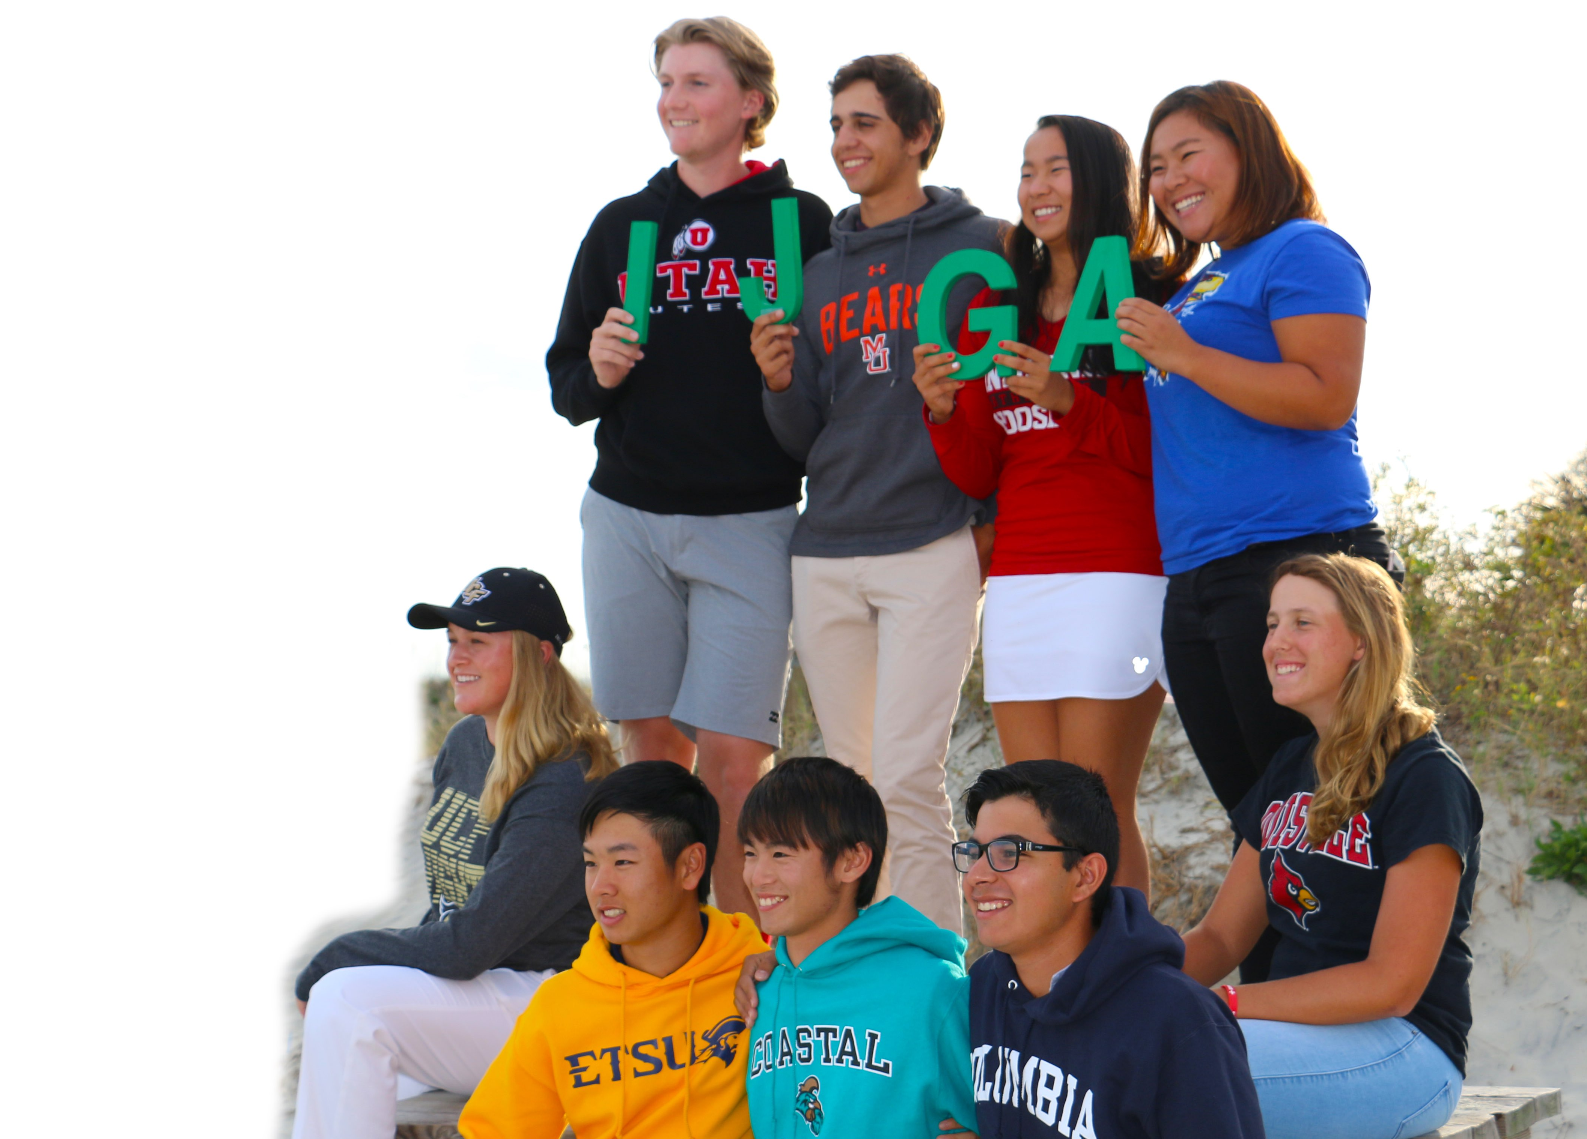

COLLEGE PLANNING & PLACEMENT
There’s a path for everyone
Start early.
Network of college coaches.
Guidance through the intricacies of the process.

Slide 27
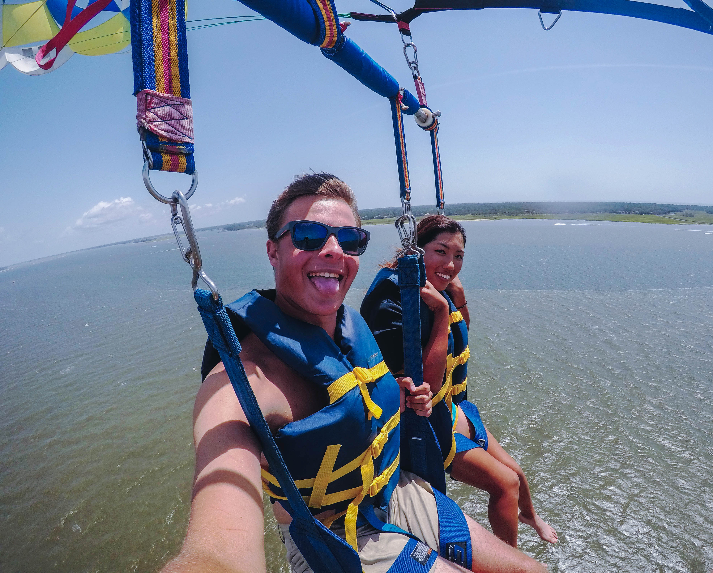
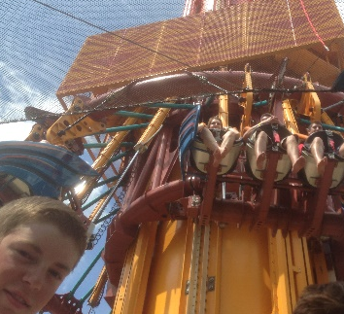
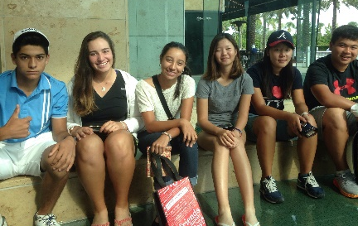
ACTIVITIES
Fun activities scheduled
on the weekend
  Shopping
  Beach
  Bowling
  Day trips
  Ice Cream
  Movies
  Kayaking
  Zip lining
  Laser Tag
  And much more

Slide 28


